Slide 1
PTA Development Days
Workshop
Developing Your Leaders
Hosted by Jennifer Hale, LAPTA VP Leadership Development
leader.develop@louisianapta.org

Slide 2
Why are we here?
Why do you PTA?
To make every child’s potential a reality
by engaging and empowering families and communities to advocate for all children.

Slide 3
Collaboration: We will work in partnership with a wide array of individuals and organizations to broaden and enhance our ability to serve and advocate for all children and families.
Commitment: We are dedicated to children’s educational success, health, and well-being through strong family and community engagement, while remaining accountable to the principles upon which our association was founded.
Respect: We value the individual contributions of members, employees, volunteers, and partners as we work collaboratively to achieve our association’s goals.
Diversity: We acknowledge the potential of everyone without regard, including but not limited to: age, culture, economic status, educational background, ethnicity, gender, geographic location, legal status, marital status, mental ability, national origin, organizational position, parental status, physical ability, political philosophy, race, religion, sexual orientation, and work experience.
Accountability: All members, employees, volunteers, and partners have a shared responsibility to align their efforts toward the achievement of our association’s strategic initiatives.
PTA
Values

Slide 4
Leadership is often defined as “the art of getting or inspiring people to do something.”
Leadership is not the same as management, which is associated with accomplishing a task in an effective and efficient manner.
A leader must often use different leadership styles, depending on the situation and group.
This Photo by Unknown Author is licensed under CC BY-NC-ND

Slide 5
Be a Servant Leader
Servant leadership is the idea that you lead by serving others. This approach works especially well in organizations like PTA, where your team is made up of volunteers.
Being a servant leader means that your focus should be on doing what needs to be done to make those below you successful.
That means that an important part of your job is building and maintaining the relationships among those on your team.

Slide 6
What is a good leader?
Appreciative
Aware
Creative
Empathetic
Enthusiastic
Fair
Flexible
Honest
Impartial
Knowledgeable
Listens
Persuasive
Responsive
Visionary

Slide 7
Get Trained
This seems like a pretty obvious starting place—you’re beginning a new job, so you ought to learn how to do it.
Perhaps you’ve been a PTA member or officer for a while and think it all looks pretty simple.
Maybe you think that the job isn’t that important because it is “just a volunteer position.”
But in reality, as a PTA you are running a non-profit organization, and with that comes legal requirements and all the skills you would need to run a non-profit.
LAPTA takes the job of affiliation seriously and tries to properly educate all Board members on PTA best practices. The Louisiana PTA Bylaws in Article IV, Section 2, Line 90 gives it the authority to set standards for Local PTA Unit affiliation.
Failure to follow policies could create personal liability and inadvertently harm the PTA.
A good leader is Knowledgeable

Slide 8
Figure Out How You Lead
There are a lot of different approaches to being a leader. Rather than trying to tailor yourself to a specific leadership style, it is far better to look at the qualities that make an effective leader, to use those that you are good at, and to work to improve those that you are weaker in.
The team you lead changes over time, whether from changes in the people on the team to growing experience on how to work together, and your leadership style will need to change to meet the current needs of your team. A good leader is flexible.
Being a leader is different from being a manager. You can be a PTA president who is simply a manager, making sure that things get done on time, events get planned and executed but being a PTA leader means moving your PTA ahead to do things it isn’t already doing. A good leader has foresight.

Slide 9
What skills does a good leader need?
Listening: You can better understand where your team wants to go.
Empathy: Understands those they lead and recognizes your team’s unique abilities and perspectives.
Awareness: Be aware of what your team needs and where they are coming from. Awareness also extends to you as a leader. Be aware of your beliefs, values, goals, and biases.
Persuasion: Focus on persuading others to achieve the goals and results you want, which means being open to the path that they suggest.
Foresight: Take the time to lift your head up from the immediate tasks at hand to focus on where you want your PTA to be at the end of your term.

Slide 10
What skills does a good leader need CONTD.?
Commitment to the Growth of People: That commitment includes taking a personal interest in everyone’s ideas and suggestions, empowering your team members to take action and be involved in the decision-making, and actively supporting each team member in the manner they need it. Doing so will provide your PTA with better leaders in the future.
Building Community: This means extending those leadership skills that you have used with your board to everyone at your school, from the principal to the teachers, staff, students, and families.
Stewardship: When you were elected, you were given the job of caring and growing your PTA for your successor.
Enthusiasm: Be positive, develop a team spirit.

Slide 11
Maintaining a good relationship with your volunteers—both regular and one-time—is critical to your PTA’s success.
Contact every person who offers to volunteer, even if you have more people than you need. The fastest way to lose a volunteer is to ignore their offer of time. A good leader is responsive.
Reconnect with volunteers throughout the year. Those who couldn’t help at the beginning of the year may be available the next time you call.
Match volunteers to potential jobs based on their skills and available time.
Arrange for an orientation for all volunteers.
Provide a variety of meaningful and manageable opportunities for volunteers, including assignments that can be done in small blocks of time and those that can be done outside of school hours.
Seek feedback. Did your volunteer feel they were prepared, helpful, and valued?
Recognize volunteers and thank them for their efforts regularly! A good leader is appreciative.
Building
a Leadership
Team
from Volunteers

Slide 12
Developing Future Leaders
Ensuring the future viability of your PTA is one of your board’s primary responsibilities. PTA boards play a vital role in developing the PTA’s next group of leaders.
Although officers cannot “name” their successors, they can ensure there are many qualified candidates ready for consideration by the Nominating Committee. For example:
Ask emerging leaders to join you in a meeting with teachers or the principal.
Give them an opportunity to take the lead on building a relationship with a new community partner or sponsor.
Encourage them to attend local training opportunities.
Encourage them to take National PTA eLearning courses.
Nominate them to chair a special committee.
This Photo by Unknown Author is licensed under CC BY-SA-NC

Slide 13
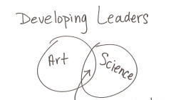
Contd…
Developing Future Leaders
It takes time. Commit yourself and your PTA to the time it will take to cultivate new leaders.
Grow your membership. Your leaders come from your members.
Show your PTA’s value. People naturally want to be part of a successful organization. Don’t limit yourself to social media. Send out a newsletter and print posters highlighting your PTA’s work.
Ask the right people. Don’t do a broadcast, target who you want to ask. (Reflections: Are there artists in your membership or students with artistic talent, ask your art teachers.)
Support your volunteers. No one wants to be assigned a job and then just left to flounder on their own. (Provide a procedure book.)

Slide 14
Keeping
Leaders &
Volunteers

Slide 15
This Photo by Unknown Author is licensed under CC BY-NC-ND
Consider doing less and having fun.
The executive board should consider if past supported events and fundraisers are too intimidating.
It may be wise to scale back the number of events, and ask for participation.
Be sure to include a social, fun event. Your community’s social well-being is important, just like student social well-being.
Events done well will encourage others to step up.

Slide 16
Make participation easy.
Look at ways to divide the work into smaller, less threatening tasks with shorter timeframes. For example, subdivide the hospitality chair role into the events: winter, spring, and summer association meetings.
Ask your officers and school staff which tasks can be done at home by volunteers.
More members may be working from home, but don’t assume they have more time. After being home bound some are hesitant socially to step out.
This Photo by Unknown Author is licensed under CC BY-SA

Slide 17
Use the buddy system to get the work done.
Every PTA association officially needs to have a president, secretary, and treasurer.
If your PTA doesn’t have additional officers, the President can call a meeting of the newly elected officers within 30 days of the election to appoint the standing committee chairs and fill any vacancies in the officer positions, subject to the approval of the Board of Directors. Check your Standing Rules for a list of the standing committees and their duties.
By creating committees to fit the needs, programs, and projects of your Local PTA, you will provide support and divide the work.
This will also help orient new volunteers with your PTA to be able to settle into new positions.
This Photo by Unknown Author is licensed under CC BY-SA

Slide 18
Expand your reach through purposeful inclusion.
Does your PTA embrace individuals included in your school community?
If families at your school speak many languages, seek volunteers who will help engage those families.
Parents of students with special needs or caring for other family members often feel left out when they cannot leave them at home.
Don’t forget students have great talent and energy. Middle school and High school students can be PTA members and they can be volunteers as well. They can get a lot out of that involvement.

Slide 19
PTAs can and should be creative.
More often than not, the new idea you have has been done before. Gain insights and ideas from others.
Reach out and connect with nearby PTAs and your council and district PTA to share ideas and success stories and pool your resources.
Attend Ask LA PTA zoom calls.
Creative leaders are fair and honest with their intentions and actions. They build an organizational culture that nurtures and cherishes the ideas of others, and removes barriers.

Slide 20
LAPTA appreciates the commitment of Local PTA Leaders to this important volunteer work.
https://www.louisianapta.org/president

Slide 21
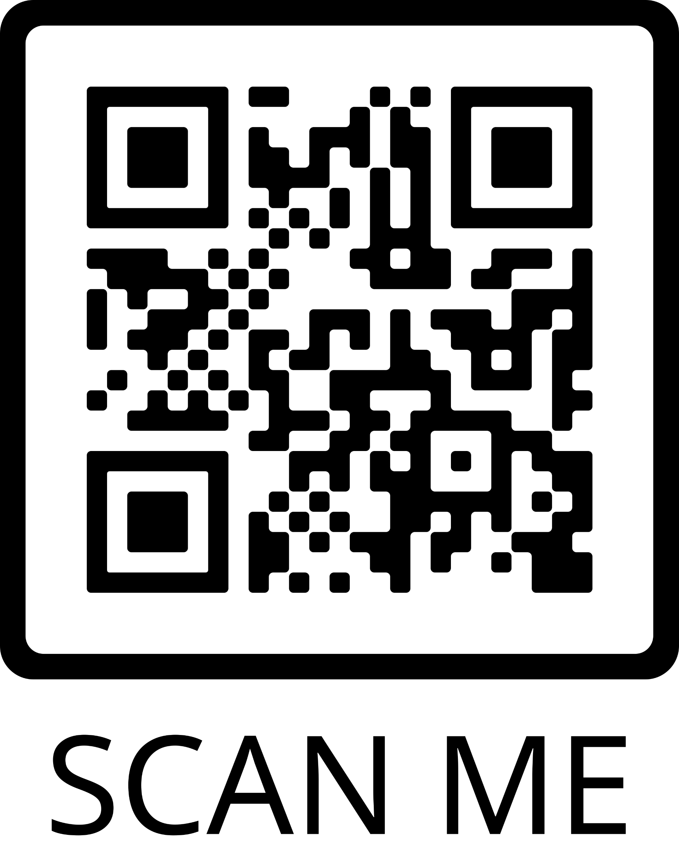
Louisiana PTA is in search of Leaders to serve on the Board of Directors
Apply Here
Email us at
president@louisianapta.org
if you are interested in learning more about volunteering at the State level.

