Slide 1
PTA Leadership Training Treasurer
Hosted by Louisiana PTA
LouisianaPTA.org/treasurer
treasurer@LouisianaPTA.org

Slide 2
Why are we here? Why do you PTA?
To make every child’s potential a reality
by engaging and empowering families and communities
to advocate for all children.

Slide 3
Sign-Ups & Downloads
Visit LouisianaPTA.org/treasurer for everything.
Download the LAPTA Toolkit: Treasurer Sec 3. The Toolkit contains further information, complete details, and all forms.
Create an account at PTA.org and create an account. There is lots of information and programs.
Register at LouisianaPTA.org/submit-officer-data-1. This is required and will allow you to receive Treasurer emails.
All officers need to be PTA members of their Local PTA Units which also makes them LAPTA and National PTA members.
LouisianaPTA.org/treasurer

Slide 4
All money shall be properly authorized, documented, tracked, and verified.
Authorization comes from the General Membership’s approving vote of the Annual Budget at the first meeting of the year.
Documentation involves receipts for expenses and deposits organized in a binder.
Tracking is through a ledger or accounting software which generates monthly reports such as MoneyMinder.com or QuickBooks.
Verification is through the annual IRS tax filing, Audit Report, and portions of the LAPTA Active Affiliation Report.
LouisianaPTA.org/treasurer

Slide 5
Getting Started
Update bank signers to have at least three authorized signers. You cannot sign a check payable to yourself. All checks need two signatures. The school principal is not allowed to be a signer.
Order debit cards for the bank signers if your PTA allows it. The PTA name and the person’s name both need to be on the debit card.
Chair the Budget Committee to create the budget. Present the Annual Budget at the first General Membership meeting. A motion needs to be made to accept the proposed budget and authorize spending.
Organize the Audit Committee to conduct the Audit Report. Members must not have been authorized bank signers.
Get a Treasurer Binder.
LouisianaPTA.org/treasurer

Slide 6
Treasurer’s Binder Sections
Accounts, debit cards, & passwords summary sheet; Board roster
Expense Forms
Deposit Forms
Monthly bank statements and reconciliation reports
Annual Budget, Budget Approval Form, monthly Budget Reports
All agendas and minutes from all meetings
Charter info: IRS tax filings, Bylaws, Standing Rules, LAPTA Toolkit: Treasurer plus Sections 1, 5 and 10, Articles of Incorporation Annual Report, Audit Reports, and insurance policy
Miscellaneous papers
LouisianaPTA.org/treasurer

Slide 7
Financial Management Principles
All PTA money must be deposited directly into a PTA’s bank account. Only PTA money can be deposited into the bank account.
There is no authorization to spend money until there is an approved budget, except for the previous budget’s “Start-Up Funds.”
Never sign a blank check or make a check out to “Cash.”
Always have two people sign every expense.
Never pay with cash.
Issue cash receipt if you receive a cash payment.
Bond/insure all officers who oversee money. This will be required next year.
LouisianaPTA.org/treasurer

Slide 8
Budget
The budget estimates the PTA’s expenses and deposits for the year which is usually July 1 through June 30.
Fundraising is used to support the programs and services of the PTA. Only raise what is needed.
The budget must include Start Up Funds which allows a PTA to spend money before the budget is approved. You should also include a Carry Forward and Year-End balances.
The Budget Committee creates the budget. The Treasurer is the chair of the committee. See your Bylaws for details on how the committee is created.
Complete the Budget Approval Form which is due October 28, 2022.
LouisianaPTA.org/treasurer

Slide 9
Sample Budget
Each line item lists its income, expense, and net totals. Use the Year-End Balance to account for unspent money. This sample budget is from MoneyMinder.com and is only a suggestion.
Section 1: Fundraising
Section 2: Student & Parent Programs
Section 3: Teacher, School, & Community
Section 4: Administrative
Do not cluster all Hospitality events into one line item. Individualize everything.
LouisianaPTA.org/treasurer

Slide 10
Comparison Budget Report
This is the monthly report that compares the actual amounts to the budget amounts.
If the budget needs to be amended to accommodate increased spending or unexpected income, then the proposed budget amendment needs to be approved by the General Membership. Note this for next year’s Audit Committee.
LouisianaPTA.org/treasurer

Slide 11
Banking & NEW E-Commerce Policy
All PTAs shall have their own checking account under their EIN (Employee Identification Number) with at least three authorized signers.
Savings accounts are allowed.
Debit cards are allowed for authorized signers only. Two signatures are required on the Expense Form. Credit cards are not allowed.
Recurring bills may be automatically paid with the debit card.
Online and point of sale payment collection systems are allowed.
Venmo and Zelle are not allowed. They leave the PTA vulnerable to fraud. PayPal is technically allowed, but there are better alternatives like CheddarUp.com or SquareUp.com.
All expenses require a completed Expense Form.
LouisianaPTA.org/treasurer

Slide 12
Banking & NEW E-Commerce Policy
All deposits shall have a completed Deposit Form.
Deposits shall be counted by two people and should be made promptly.
Checks may be deposited electronically. Note confirmation number and date. Don’t destroy the check until the deposit clears.
Deposit transfers from online accounts must occur at least monthly.
Bank statements are mailed to the PTA’s permanent address which is the school’s address. Paperless or electronic bank statements are allowed.
Have a non-bank signer review and sign every bank statement. This is easily done at Board meetings.
Follow up with all NSF checks for repayment plus bank fees.
LouisianaPTA.org/treasurer

Slide 13
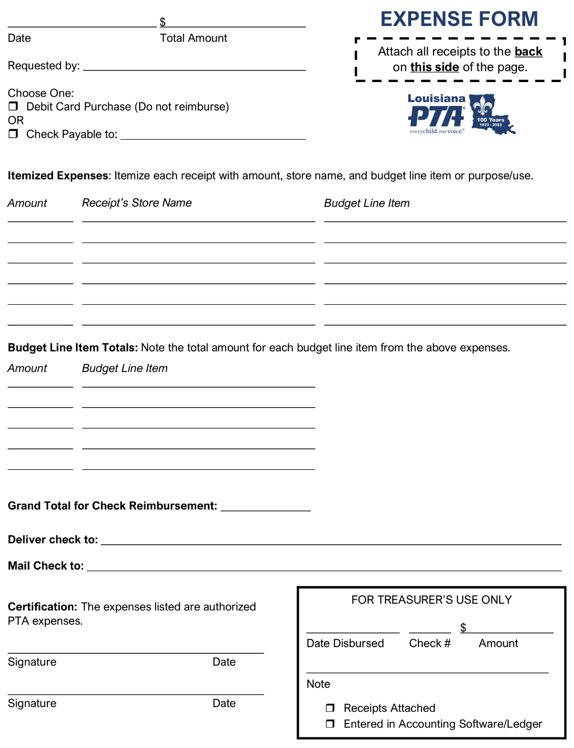
Expense Form
Staple receipts to upper right.
Note if it is a debit purchase or if it is to be reimbursed.
Itemize each expense (receipt) and its budget item.
Note the total for each budget item.
Write the grand total.
Get two authorized signatures.
Complete Treasurer’s Use box.
LouisianaPTA.org/treasurer

Slide 14
Deposit Form
Itemize each check with Name, check number, and amount.
Tally the cash and coin denominations.
Total the number of checks.
Note the check, cash, and coin totals and the grand total.
List the budget items to be credited.
Cash deposits require 2 signatures.
Note deposit date, amount, and if it is entered into software/ledger.
Staple deposit slip to back right.
LouisianaPTA.org/treasurer

Slide 15
MoneyMinder.com & CheddarUp.com
LAPTA encourages the use of online platforms to collect membership dues and to track finances.
MoneyMinder.com ($179/year) is simple accounting software for non-profits. It tracks expenses and deposits, has easy budget set-up, runs reports, and maintains history over the years.
CheddarUp.com works as an online store and a simple website. The Basic level is free. E-checks are 0.4% + 59₵ fee. Credit cards are 3.9% + 59₵ .
Use the link CheddarUp.com/?ref=LouisianaPTA to get 15% savings off a CheddarUp.com paid account. LAPTA gets a small referral commission.
If you have both, get the $30/month CheddarUp Team Edition free.
See a CheddarUp sample at FriendsofLAPTA.CheddarUp.com.
LouisianaPTA.org/treasurer

Slide 16
Treasurer’s Monthly Duties
Attends and presents the Budget Report at all PTA meetings.
Reconciles the bank account which is easily done with MoneyMinder.com. Present the reconciliation report at all Board meetings.
Review all Expense and Deposit Forms for the month to get any missing information or receipts. Make sure all transactions are accounted for.
Have bank statement reviewed and signed by a non-signer.
Submit member dues for new members at LouisianaPTA.org/membership. All PTAs submit $3.50 for each of their members to LAPTA. LAPTA pays $2.25 to National PTA and retains $1.25 for itself. Tax reporting detail will be explained later.
LouisianaPTA.org/treasurer

Slide 17
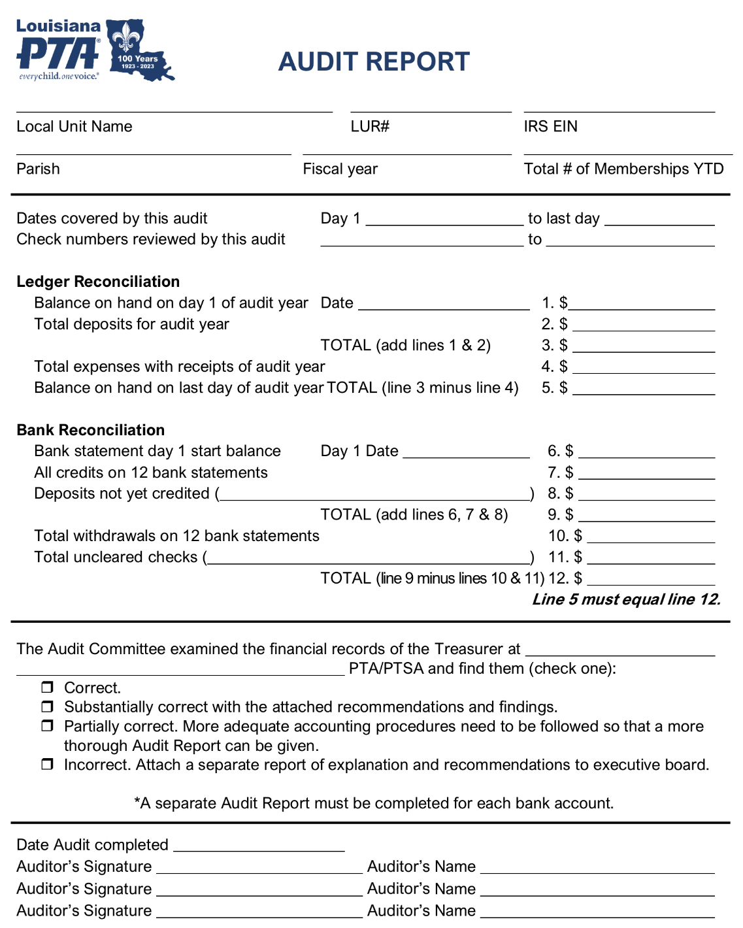
Audit Committee and Report
The Audit Report is an annual review of the previous year’s finances by the Audit Committee which is at least three people. This is due October 28, 2022.
The report compares the bank statement transactions to the actual receipts in the binder. The form with complete instructions are in the LAPTA Toolkit: Treasurer.
LouisianaPTA.org/treasurer

Slide 18
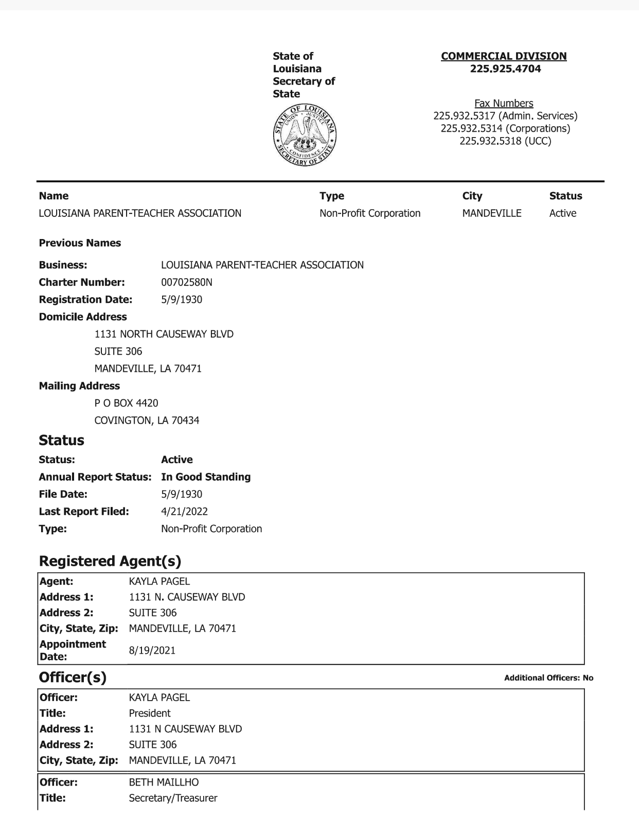
Annual Renewals
The Louisiana Secretary of State requires all non-profits to annually file an update. Go to GeauxBiz.com, log in, update the officer data, and pay the $15 fee.
Renew the insurance policy. This is frequently with AIM, although any company is acceptable. Insurance will be required next year. It starts around $220 per year.
Renew online subscriptions such as MoneyMinder.com and Zoom.
LouisianaPTA.org/treasurer

Slide 19
Federal & State Taxes
Federal tax filing for 2021-22 year is due 4 ½ months after the fiscal year ends, which is usually November 15. Non-profits file a 990 online with IRS.gov or efile.form990.org. There are different forms based on the gross income amount.
Form 990-N is for gross income less than $50,000. Electronic filing only.
Form 990-EZ is for gross income $50,000 - $200,000.
Form 990 is for gross income more than $200,000.
All money given to the PTA is a tax-deductible donation. “Thank you for your tax-deductible donation.”
PTAs pay sales tax on all purchases. (Schools do not pay sales tax.)
LouisianaPTA.org/treasurer

Slide 20
Federal & State Taxes
Federal tax filing for 2021-22 year is due 4 ½ months after the fiscal year ends, which is usually November 15. Non-profits file a 990 with IRS.gov. There are different forms based on the gross income amount.
Form 990-N is for gross income less than $50,000. (electronic file)
Form 990-EZ is for gross income $50,000 - $200,000.
Form 990 is for gross income over $200,000.
When calculating gross income, EXCLUDE member dues paid to LAPTA. For example, if you had $1200 total income and paid $434 to LAPTA for 124 members, you would net $766. Report the gross income from dues as $766.
PTAs are to pay state sales tax on “Unrelated Business Income.” LAPTA is working to acquire an exemption for each parish, but this is not granted yet. Refer to www.rev.state.la.us for further details.
LouisianaPTA.org/treasurer

Slide 21
Active Affiliation Report Due October 28, 2022
The documentation is uploaded online through JotForm which is listed at LouisianaPTA.org/active-affiliation.
Proof of at least 30 membership dues submitted to LAPTA
Proof of Leadership Training for all officers from LAPTA or National PTA
First page of your Bylaws (updated every 3 years; new template available)
Proof that the 2020 Federal Taxes were filed
Budget Approval Form and the approved Annual Budget
Audit Report
Updated Articles of Incorporation from LA Secretary of State
Insurance declaration page, if applicable (required next year)
LouisianaPTA.org/treasurer

Slide 22
Year-End Duties The Year-End Financial Checklist is in the Toolkit.
Have the Passwords & Accounts Summary Sheet accurate and up to date.
All Expense & Deposit Forms are documented, complete, and entered into accounting software/ledger.
All bank statements, monthly reconciliation reports, budget reports, agendas, minutes, and annual budget are included.
Include previous Audit Report, EIN, Articles of Incorporation, proof of 2021 IRS tax filing, and insurance declaration page.
Review records retention policy and keep required documents.
Meet with the incoming Treasurer and President. Turn over check book, debit cards, binder, past records, and all PTA papers. Be available for any questions for the next Audit Committee.
LouisianaPTA.org/treasurer

Slide 23
Summary
Know the LAPTA Toolkit: Treasurer Section 3.
Get the budget approved by the General Membership ASAP.
Active Affiliation Report is due October 28, 2022. Work on it now.
2021 IRS Tax filing is due November 15 (for most). Do it now.
Submit member dues monthly through LousianaPTA.org/membership.
Debit cards are allowed only if each purchase has two signatures.
There will be future Zoom meetings to cover Treasurer questions.
Contact LAPTA Treasurer Beth Maillho at (985) 778-5799 or email at treasurer@LouisianaPTA.org.
THANK YOU for volunteering and supporting the PTA mission of helping all children reach their potential.
LouisianaPTA.org/treasurer

