Slide 1
PTA Development Days
Active Affiliation
Workshop
Hosted by Beth Maillho, LAPTA, VP Affiliation
Affiliation@LouisianaPTA.org
(985) 778-5799

Slide 2
Why are we here?
Why do you PTA?
To make every child’s potential a reality
by engaging and empowering families and communities to advocate for all children.

Slide 3
PTA
V A L U E S
Collaboration: We will work in partnership with a wide array of individuals and organizations to broaden and enhance our ability to serve and advocate for all children and families.
Commitment: We are dedicated to children’s educational success, health, and well-being through strong family and community engagement, while remaining accountable to the principles upon which our association was founded.
Respect: We value the individual contributions of members, employees, volunteers, and partners as we work collaboratively to achieve our association’s goals.
Diversity: We acknowledge the potential of everyone without regard, including but not limited to: age, culture, economic status, educational background, ethnicity, gender, geographic location, legal status, marital status, mental ability, national origin, organizational position, parental status, physical ability, political philosophy, race, religion, sexual orientation, and work experience.
Accountability: All members, employees, volunteers, and partners have a shared responsibility to align their efforts toward the achievement of our association’s strategic initiatives.

Slide 4
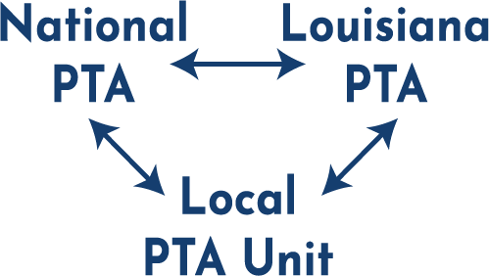
Active Affiliation
Affiliation is the connection or relationship between National PTA, Louisiana PTA, and the Local PTA Unit. While the PTA Unit operates independently from day to day, it is legally attached to National PTA and LAPTA. It is similar to a franchise relationship.
The previous District PTAs closed and consolidated into LAPTA.

Slide 5
What is Active Affiliation?
Local PTAs annually submit required paperwork to Louisiana PTA. LAPTA then submits paperwork to National PTA to keep everyone in Active Affiliation.
To have “Active Affiliation” means that the Local Unit is current with its obligations to maintain its IRS status and National PTA affiliation.
The Active Affiliation Report includes nine items. The files are easily uploaded online by scanning the QR Code or visit form.jotform.com/221816998285068. Most file formats are accepted.
The deadline is October 27, 2023. If a PTA does not submit the report, they move into the Retention Phase.

Slide 6
Retention Phase
For PTA who do not file the paperwork by October 27, 2023, then they enter into the Retention Phase. Some PTA officers might inherit a PTA not in compliance and might not even know about Active Affiliation while others might knowingly not comply. The reason doesn’t matter. It’s more important about what direction they are working toward.
Communication with LAPTA is key. Local Units will not be “in trouble” or scolded, but rather LAPTA welcomes their efforts and want to work together to get Local Units back to Active Affiliation status.
Ask for help! Contact VP of Affiliation Beth Maillho at (985) 778-5799 or Affiliation@LouisianaPTA.org or President Kayla Pagel at (757) 338-0513 or president@LouisianaPTA.org.

Slide 7
Steps of the Retention Plan
Notification: LAPTA gives 30 days to submit the missing items.
Restriction: The Local PTA Unit is given a second 30-day period to submit the missing items and are additionally not eligible for awards, programs, or grants by LAPTA or National PTA.
Intervention: After 60 days, the PTA signs a Plan of Action which designates new deadlines for the missing items.
Restructure: If the PTA does not complete the report, LAPTA may choose to restructure the leadership of the PTA or choose to move into the Dissolution Phase.
Dissolution: A Local Unit is considered for revocation of their charter and loss of their LAPTA associated IRS 501(c)(3) nonprofit status if: Active Affiliation is not acquired for 3 consecutive years; PTA leadership refuses to implement the Plan of Action; or the PTA is not in compliance with the Purposes and Principles of PTA as defined in the Bylaws, adopted May 2022, Articles II and III. The PTA must cease and desist further use of the PTA name. Bank accounts must be closed with any remaining funds donated to a PTA.

Slide 8
Once the PTA fully submits their affiliation requirements, they will receive the 501(c)(3) Validation Letter which proves to other businesses that it is a valid non-profit.

Slide 9
1.) Membership
Each PTA must purchase a minimum of 30 PTA memberships from LAPTA (which includes National PTA dues as well).
The PTA is obligated to submit dues to LAPTA and National PTA for each person that joins their PTA. The total dues for both is $3.50 per person. LAPTA retains $1.25 and then submits to National PTA $2.25 per person on behalf of the Local PTA Units.
To submit dues, go to LouisianaPTA.org/membership and follow the link to Submit Member Dues through CheddarUp.
For the AA Report, upload the email confirmation of purchase. Save it as a PDF, Word doc, screen shot, etc.

Slide 10
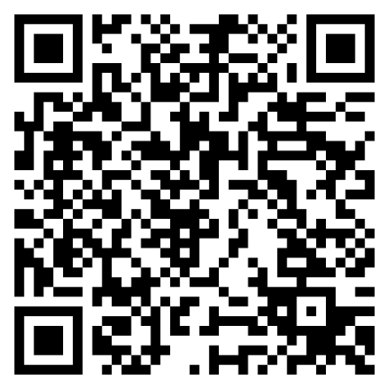
2.) Register Officers & Board of Directors
Submit to Louisiana PTA the name and contact information of all
Board and Committee Chairs within 15 days of election or appointment at LouisianaPTA.org/register or scan the QR Code.
Every PTA is required to have a President, Treasurer, and Secretary.
This is how LAPTA communicates with the Local PTA Units. If LAPTA does not have your information, you will not know what is happening.
Please READ all emails closely that you get from LAPTA. It is an important duty as a PTA leader.
For the AA Report, list all elected officers, their position, and if they are registered.
Example: Kayla Pagel, President, registered

Slide 11
3.) Bylaws
The Bylaws define the primary characteristics of the organization, prescribe how the association functions, and include all rules considered important to the rights and responsibilities of its membership.
The LAPTA Bylaws Template includes required language which cannot be changed and allows the local PTA to customize only certain details.
Bylaws expire every three years. Check to see when your Bylaws expire. Visit LouisianaPTA.org/bylaws or search in the Toolkit.
If you need a copy of your Bylaws, email bylaws@LouisianaPTA.org.
For the AA Report, upload the first page of Bylaws showing the LAPTA approval stamp and approval date in any file format.

Slide 12
4.) Taxes
LAPTA and all subordinate units in Active Affiliation are exempt from federal income tax as charitable organizations under the provisions of section 501(c)(3) of the IRS.
Annually, LAPTA is required to submit to the IRS a list of all units in Active Affiliation who are covered by the group exemption. Any unit not listed would be subject to INCOME TAX on all earnings.
See LAPTA Toolkit: Treasurer for details on filing Form 990.
For the AA Report, upload proof of 2021 filed and accepted IRS Form 990 tax filing in any file format.
2022 Tax Filings are due to the IRS by November 15, 2023.

Slide 13
5.) Budget
The proposed budget is presented to the Board of Directors for any changes. Then the proposed budget is presented to the General Membership line by line for their final approval.
Complete the Local PTA Budget Approval Form located in the Treasurer Toolkit or LouisianaPTA.org/treasurer.
For the AA Report, upload the
Local PTA Budget Approval Form AND the
Approved Annual Budget in any file format.

Slide 14
6.) Audit
The Audit Committee of at least three people who are not bank signers reviews the books and completes the Audit Committee Report. This report is in the Toolkit.
It compares the receipts in the binder to the bank statement as well as the actual budget amounts to the approved budget amounts.
For the AA Report, upload the completed Audit Committee Report for 2022 in any file format.

Slide 15
7.) Articles of Incorporation
The Louisiana Secretary of State requires all nonprofits to annually file. Go online to GeauxBiz.com, log in, update the officer data, and pay the $15 renewal fee. Save the report to your files.
Find out when your Annual Report expires.
For the AA Report, upload the active Articles of Incorporation Annual Report.

Slide 16
8.) Insurance
LAPTA now requires all PTAs to obtain adequate insurance protection against liability and monetary loss due to fraud or dishonest acts.
Purchase insurance coverage from any company such as Association Insurance Management (AIM), a company that offers coverage to PTAs and other nonprofits at a reasonable price. For more information, contact AIM at (800) 876-4044 or AIM-companies.com.
Go to LouisianaPTA.org/treasurer for an explanation video from AIM.
For the AA Report, upload the insurance declaration page, if applicable, in any file format.

Slide 17
9.) Training
All elected officers need annual PTA Leadership Development and Training. Other Board members are encouraged to receive training especially since all Board members should understand the other positions and roles.
Sources for training are:
LAPTA Leadership Training Days
LAPTA Zoom Training Meetings in September
LAPTA Individualized Training in person or Zoom as needed
For AA Report, upload the certificates or other proof of training for all officers in any file format.

Slide 18
501(c)(3) Validation Letter
Once the affiliation requirements are fulfilled, LAPTA emails the 501(c)(3) Validation Letter to the PTA proving its nonprofit status.
Summary
Active Affiliation Report is due October 27, 2023.
Visit LouisianaPTA.org/activeaffiliation for details. Most forms are at LouisianaPTA.org/treasurer.
File online at form.jotform.com/221816998285068.
It can be filed in multiple times, but one submittal is preferred. If you do not have it done by the deadline, keep working on it. Email affiliation@LouisianaPTA.org to give an update on your situation.
We are all on the same team and work together to get it done! Contact VP of Affiliation Beth Maillho at (985) 778-5799 or Affiliation@LouisianaPTA.org with questions.

Slide 20
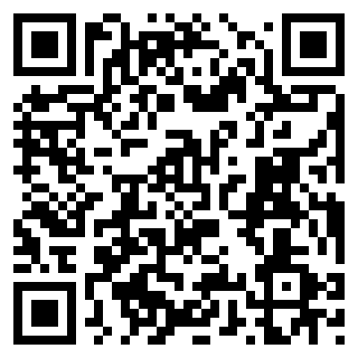
Louisiana PTA is in search of Leaders to serve on the Board of Directors
Apply Here
Email us at
president@louisianapta.org
if you are interested in learning more about volunteering at the State level.

