Slide 1
PTA Leadership Training Active Affiliation
Hosted by Louisiana PTA
LouisianaPTA.org/active-affiliation
treasurer@LouisianaPTA.org

Slide 2
Why are we here? Why do you PTA?
To make every child’s potential a reality
by engaging and empowering families and communities
to advocate for all children.
LouisianaPTA.org/active-affiliation

Slide 3
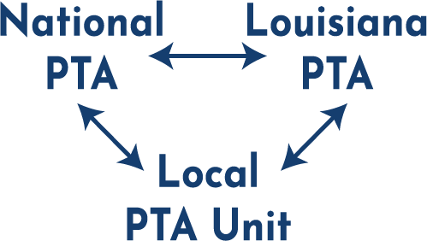
What is Affiliation?
Affiliation is the connection or relationship between National PTA, Louisiana PTA, and the Local PTA Unit. While the PTA Unit operates independently from day to day, it is legally attached to National PTA and LAPTA. It is similar to a franchise relationship.
The previous District PTAs closed and consolidated into LAPTA.
LouisianaPTA.org/active-affiliation

Slide 4
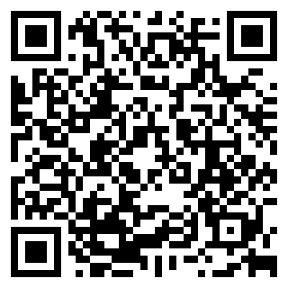
What is Active Affiliation?
Local PTAs annually submit required paperwork to Louisiana PTA. LAPTA then submits paperwork to National PTA, keeping all of us in Active Affiliation.
To have “Active Affiliation” means that the Local Unit is current with its obligations to maintain its IRS status and National PTA affiliation.
The Active Affiliation Report includes nine items. The files are easily uploaded online at https://form.jotform.com/221816998285068 or scan the QR Code. Most file formats are accepted.
The deadline is October 28, 2022. If a PTA does not submit the report, they move into the Retention Phase.
LouisianaPTA.org/active-affiliation

Slide 5
What is Retention Phase?
For PTA Units who do not file the paperwork by October 28, 2022, then they enter into the Retention Phase. Some PTA officers might inherit a PTA not in compliance and might not even know about Active Affiliation while others might knowingly not comply. The reason doesn’t matter. It’s more important about what direction they are working toward.
Communication with LAPTA is key. Local Units will not be “in trouble” or scolded, but rather LAPTA welcomes their efforts and want to work together to get Local Units back to Active Affiliation status.
Ask for help! Contact LAPTA Treasurer Beth Maillho at (985) 778-5799 or treasurer@LouisianaPTA.org or President Kayla Pagel at (757) 338-0513 or president@LouisianaPTA.org.
LouisianaPTA.org/active-affiliation

Slide 6
Steps of the Retention Plan
Notification: 30-days notice that the deadline passed without submission.
Restriction: given another 30 days to be in compliance; not eligible for PTA awards, grants, or programs.
Restructure: LAPTA might restructure the Local PTA leadership, or the Local PTA can create a “Plan of Action.”
Intervention: Once the Plan of Action is implemented, LAPTA assist as needed.
Dissolution: A Local PTA Unit is considered for revocation of its charter, its association with PTA, and its nonprofit status if it does not have Active Affiliation for three years or sooner if the leadership will not implement Plan of Action. This is a simplified summary.
LouisianaPTA.org/active-affiliation

Slide 7
Reactivation Phase
If a PTA has not maintained Active Affiliation for at least three years but wants to reaffiliate with Louisiana PTA and the National PTA, then the Local Unit may move into the Reactivation Phase.
First, contact LAPTA at president@LouisianaPTA.org. It is usually recommended that you apply online for a new EIN with the IRS with a new PTA unit name.
Complete the Reactivating an Existing PTA Packet.
LouisianaPTA.org/active-affiliation

Slide 8
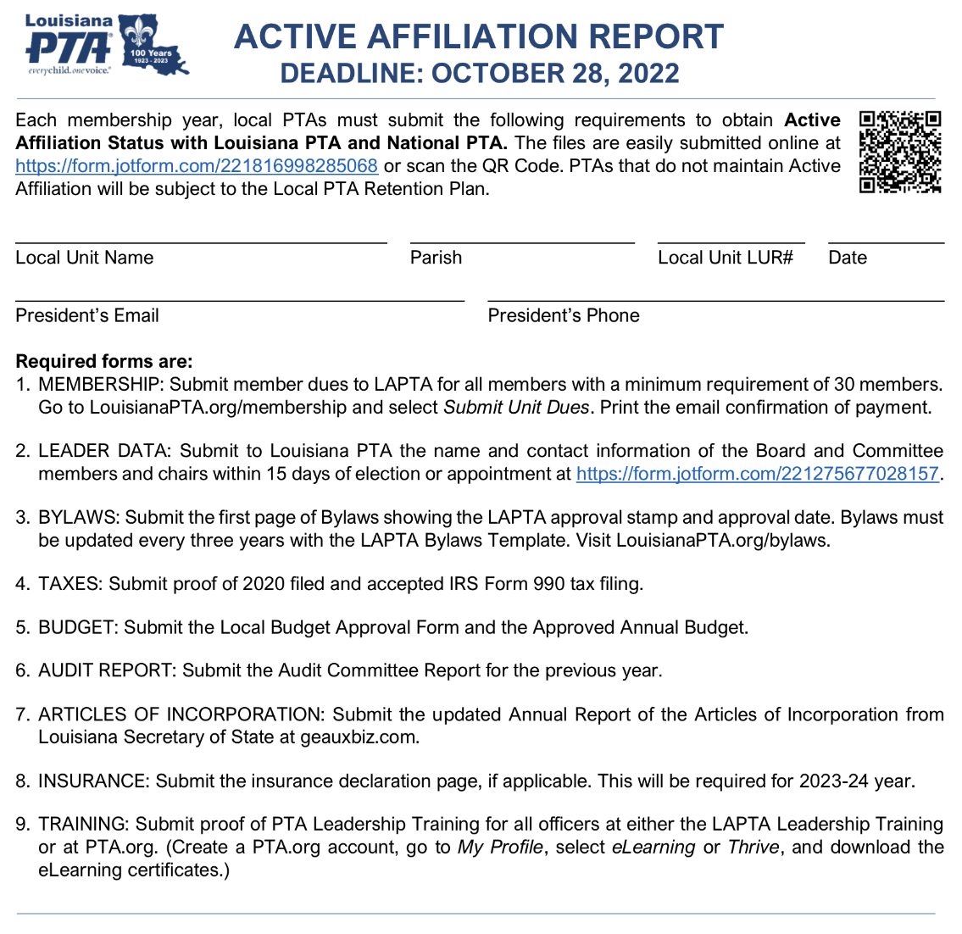
Active Affiliation
Report Summary
There are nine requirements for the Active Affiliation Report.
The requirements cover membership, officer data, Bylaws, federal tax filing, budget, audit, Articles of Incorporation, insurance, and training.
This form is in the Toolkit as a guide. Submitting the report is done online without the form.
LouisianaPTA.org/active-affiliation

Slide 9
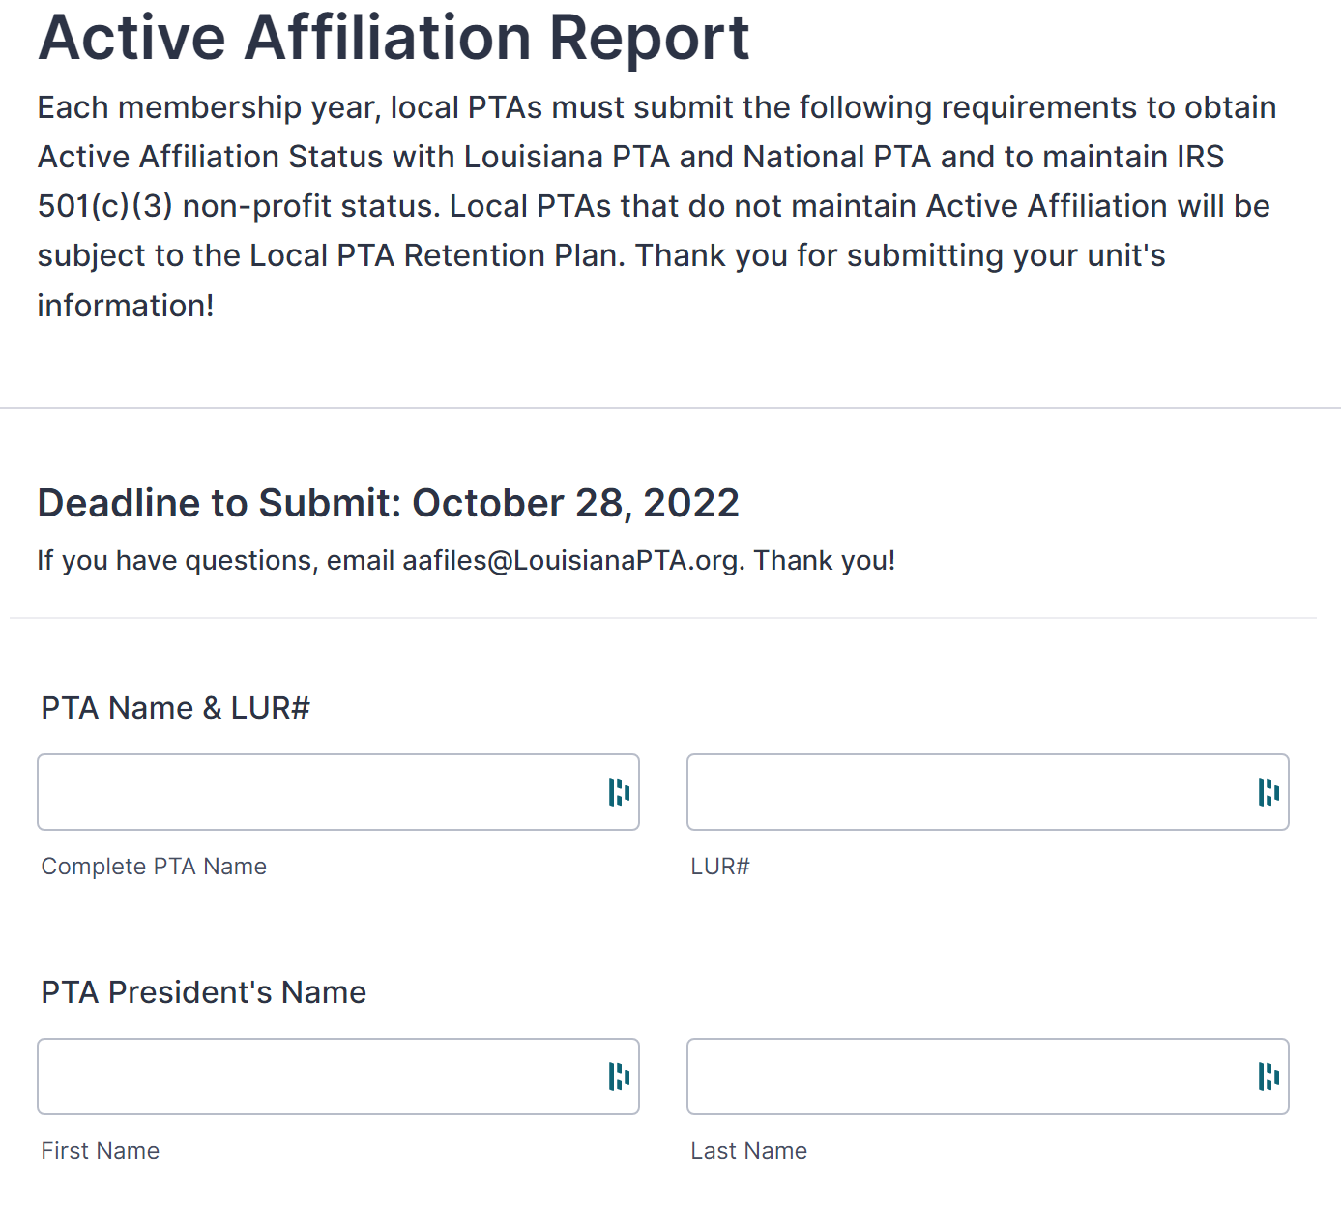
Time to Start Filing
Scan the QR Code or go to https://form.jotform.com/221816998285068.
You’ll enter the PTA Name, LUR#, President’s name, email, and phone.
LouisianaPTA.org/active-affiliation

Slide 10
1.) Membership
The first requirement is that each PTA purchases a minimum of 30 PTA memberships from LAPTA (which includes National PTA dues as well).
The local PTA is obligated to submit dues to LAPTA and National PTA for each person that joins their PTA. The total dues for both is $3.50 per person. LAPTA retains $1.25 and then submits to National PTA $2.25 per person on behalf of the Local PTA Units.
To submit dues, go to LouisianaPTA.org/membership and follow the link to Submit Member Dues through CheddarUp.
For the AA Report, upload proof of at least 30 memberships using the email confirmation of purchase. Save it as a PDF, Word doc, screen shot, etc. You can upload many different file or image types.
LouisianaPTA.org/active-affiliation

Slide 11
1.) Membership
LouisianaPTA.org/active-affiliation

Slide 12
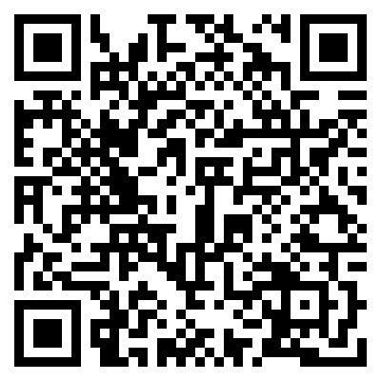
2.) Officer Data
Submit to Louisiana PTA the name and contact information of all Board and Committee Chairs within 15 days of election or appointment at https://form.jotform.com/221275677028157 or scan the QR Code.
Every PTA is required to have a President, Treasurer, and Secretary. This information shows to LAPTA that the minimum is met.
This is how LAPTA communicates with the Local PTA Units. If LAPTA does not have your information, you will not know what is happening.
Please READ all emails closely that you get from LAPTA. The emails are succinct and pertinent. It is an important duty as a PTA leader.
For the AA Report, list all elected officers, their position,
and if they are registered. Example: Kayla Pagel, President, registered
LouisianaPTA.org/active-affiliation

Slide 13
3.) Bylaws
The Bylaws define the primary characteristics of the organization, prescribe how the association functions, and include all rules considered important to the rights and responsibilities of its membership.
The LAPTA Bylaws Template includes required language which cannot be changed and allows the local PTA to customize only certain details.
Bylaws expire every three years. Check to see when your Bylaws expire. It is recommended you update your Bylaws this year with the new template. Visit LouisianaPTA.org/bylaws or search in the Toolkit.
If you need a copy of your Bylaws, email bylaws@LouisianaPTA.org.
For the AA Report, upload the first page of Bylaws showing the LAPTA approval stamp and approval date in any file format.
LouisianaPTA.org/active-affiliation

Slide 14
4.) Taxes
LAPTA and all subordinate units in Active Affiliation are exempt from federal income tax as charitable organizations under the provisions of section 501(c)(3) of the IRS.
Annually, LAPTA is required to submit to the IRS a list of all units in Active Affiliation who are covered by the group exemption. Any unit not listed would be subject to INCOME TAX on all earnings.
See the LAPTA Toolkit: Treasurer for details on filing Form 990.
For the AA Report, upload proof of 2020 filed and accepted IRS Form 990 tax filing in any file format.
The 2021 Tax Filings are due to the IRS by November 15, 2022.
LouisianaPTA.org/active-affiliation

Slide 15
5.) Budget
The budget is a financial guide that outlines estimated income and expenditures based on the Local PTA Unit’s goals. To be effective, the budget must determine what realistic expenses will be for the year and how to secure the necessary funds to meet these disbursements. The budget should cover your fiscal year usually from July 1 to June 30.
The proposed budget is presented to the Board of Directors for any changes and approval. Then the proposed budget is presented to the General Membership line by line for their final approval.
Complete the Local PTA Budget Approval Form located in the Treasurer Toolkit or LouisianaPTA.org/treasurer.
For the AA Report, upload the Local PTA Budget Approval Form and the Approved Annual Budget in any file format.
LouisianaPTA.org/active-affiliation

Slide 16
6.) Audit
An audit follows financial transactions through the records to be sure that receipts are properly accounted for and expenditures are made as authorized in the approved budget and in conformity with PTA Bylaws for all PTA accounts.
The Audit Committee of at least three people who are not bank signers reviews the books and completes the Audit Committee Report. This report is in the Toolkit and due on October 28, 2022, as part of the Active Affiliation Report.
It compares the receipts to the bank statements and the actual budget amounts to the approved budget amounts.
For the AA Report, upload the completed Audit Committee Report for 2021 in any file format.
LouisianaPTA.org/active-affiliation

Slide 17
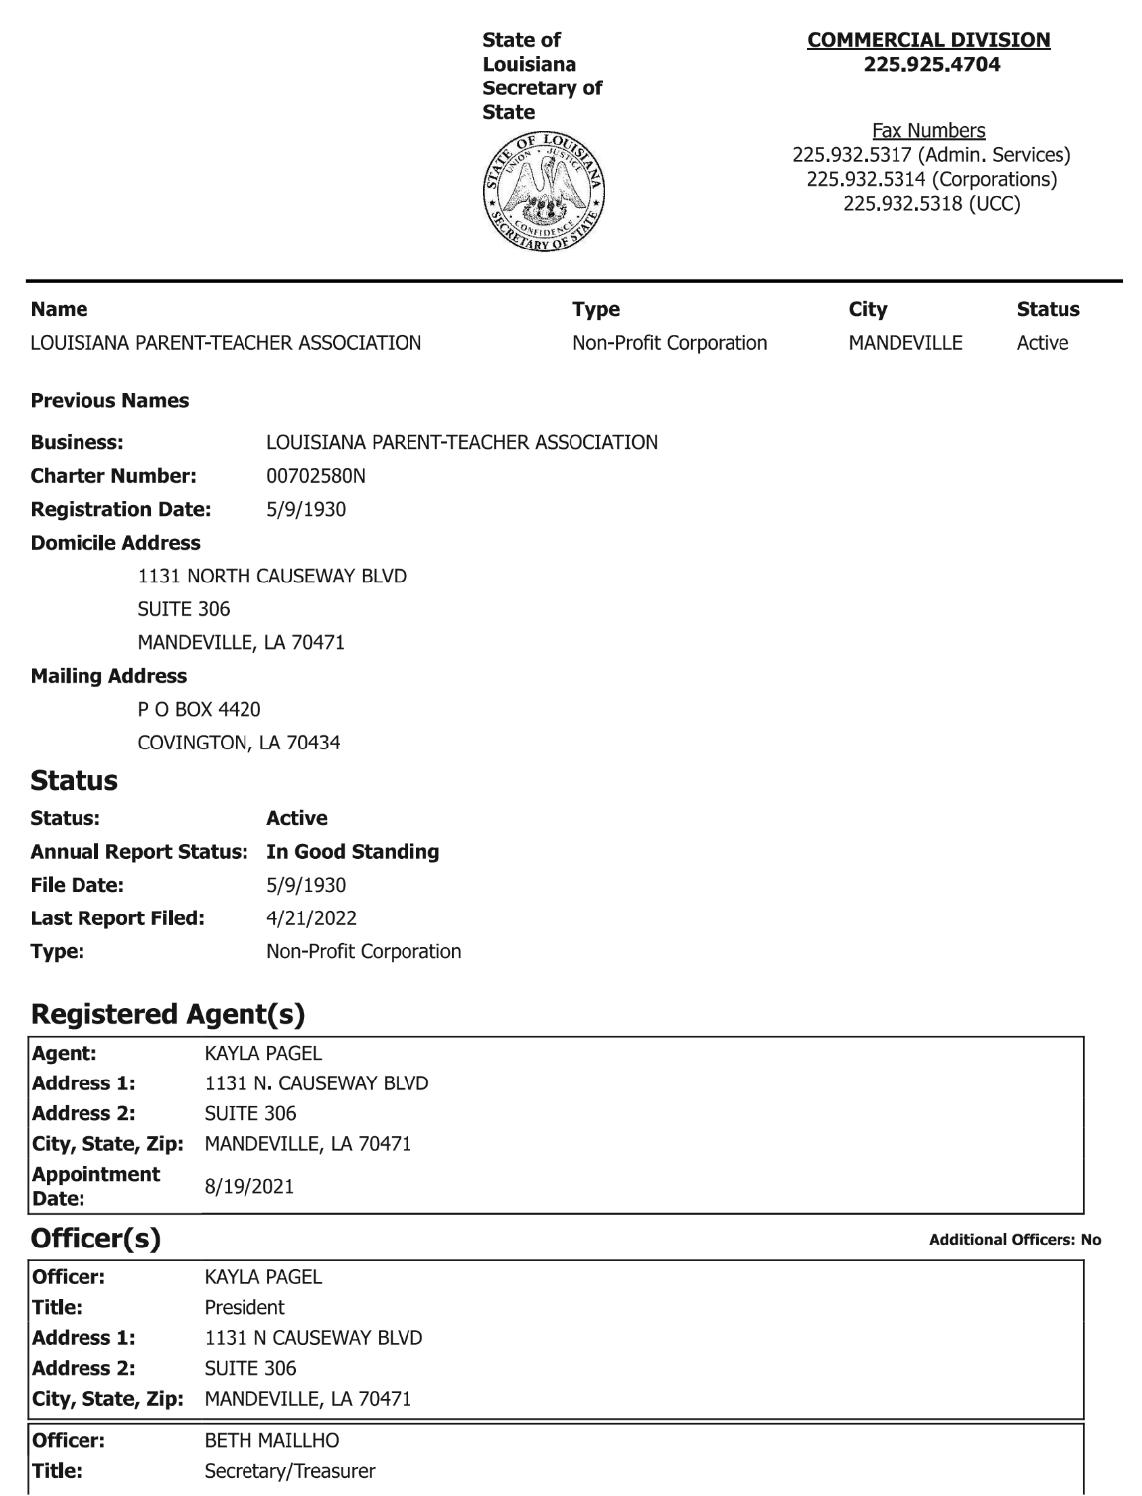
7.) Articles of Incorporation
The Louisiana Secretary of State requires all nonprofits to annually file. Go online to GeauxBiz.com, log in, update the officer data, and pay the $15 renewal fee. Save the report to your files.
Find out when your Annual Report expires. If they aren’t due to renew, it’s tricky finding the renewal link.
For the AA Report, upload the active Articles of Incorporation Annual Report.
LouisianaPTA.org/active-affiliation

Slide 18
8.) Insurance
LAPTA strongly encourages PTAs to obtain adequate insurance protection against liability and monetary loss due to fraud or dishonest acts. Purchase insurance coverage from a company such as Association Insurance Management (AIM), a company that offers coverage to PTAs and other nonprofits at a reasonable price. AIM policies run annually from October to September. For more information, contact AIM at (800) 876-4044 or AIM-companies.com.
Go to LouisianaPTA.org/treasurer for an explanation video from AIM.
Insurance will be required next year.
For the AA Report, upload the insurance declaration page, if applicable, in any file format.
LouisianaPTA.org/active-affiliation

Slide 19
9.) Training
All elected officers shall complete annual PTA Leadership Training. Other Board members are encouraged to receive training. Board members should understand the other positions and roles within the Board.
Sources for training are:
LAPTA Leadership Training Days (You’ll receive proof of training for today!)
LAPTA Individualized Training: This is either in person or Zoom training with LAPTA and scheduled as needed.
For AA Report, upload the certificates or other proof of training for all officers in any file format.
LouisianaPTA.org/active-affiliation

Slide 20
Summary
Active Affiliation Report is due October 28, 2022. Get it done early!
File online at https://form.jotform.com/221816998285068.
It can be filed in multiple times, but one submittal is preferred.
If you do not have it done by the deadline, keep working on it, and email aafiles@LouisianaPTA.org to give an update on your situation.
Most forms and further information is in the LAPTA Toolkit: Treasurer which is at LouisianaPTA.org/treasurer.
We are all on the same team and will work with you to get it done! Contact LAPTA Treasurer Beth Maillho at treasurer@LouisianaPTA.org with questions.
LouisianaPTA.org/active-affiliation

