Slide 1
PTA Development Training
Reflections Program 23-24 Introduction
I Am Hopeful Because……..
Hosted by Louisiana PTA
LouisianaPTA.org

Slide 2
Why are we here? Mission:
To make every child's potential a reality by engaging and empowering families and communities to advocate for all children.
This Photo by Unknown Author is licensed under CC BY-SA-NC

Slide 3
23-24 Theme: I Am Hopeful Because………
Notes:
Founded in 1969, National PTA’s 50+year Reflections program provides opportunities for recognition and access to the arts. Each year students across the world in Pre-K through Grade 12 create original works of art in response to a student-selected theme. Students submit their completed works of art in one or all of the available arts categories: Dance Choreography, Film Production, Literature, Music Composition, Photography, and Visual Arts. In addition to these categories, the Special Artist division allows students with disabilities, from all grades, to participate and utilize non-artistic accommodations.

Slide 4
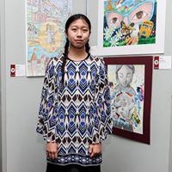
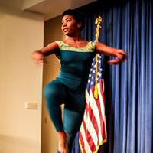
Local Reflections Chair Duties
Local PTAs should run their Reflections program according to their state’s requirements. General Local Reflections leader tasks include:
Registering your Local PTA and connect with your state’s Reflections program at PTA.org/Reflections
Editing and distributing program materials
Recruiting volunteer judges
Collecting entries and coordinating the art review process
Advancing finalists to the next review round
Celebrating and recognizing students
Notes:
The Reflections program is largely managed on the state-level by State Reflections Chairs. Local PTAs should implement the program based upon the specific forms, deadlines and guidelines which are required by each State PTA.
Head to PTA.org/reflections/StartYourProgram to find the State Reflections Guidelines map and connect with your State Reflections leaders.
On this slide, please find general Local Reflections Leader responsibilities.

Slide 5
Reflections Program Theme
Inspire hundreds of thousands of student artists each year
The Reflections program theme is student-selected and changes annually.
Students submit their themes in the Annual Theme Search Contest according to their State PTA and National PTA’s Reflections theme search guidelines. One national winner is selected by the National PTA in February.
The winner’s theme inspires students across the country and in U.S. schools overseas that participate in the Reflections program. The winning student will also receive a $100 award and national recognition.
LAPTA will host a Theme Search with all information online – look for it in July 2023!
Notes:
Every Reflections theme, is student created and was submitted during the National PTA Reflections Theme Search Contest.
Find out if your state is participating in the Reflections Theme Contest and confirm state deadlines and requirements.
You can learn more about the theme contest at PTA.org/ReflectionsAwards

Slide 6
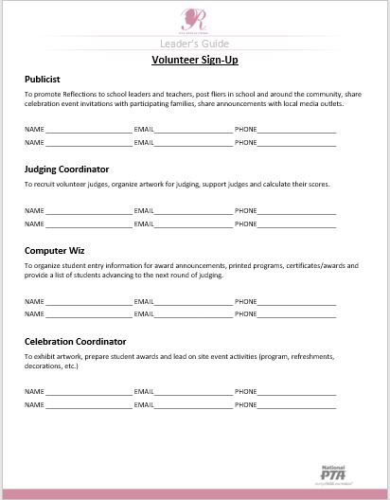
1. Register, Connect, Recruit
Register your PTA in the National PTA Reflections program at PTA.org/Reflections.
Register your PTA with LAPTA: https://form.jotform.com/231397127809160
Promote Reflections by Celebrating
National Arts in Education Week - beginning the second Sunday in September
National Arts and Humanities Month - October
Recruit Volunteers for your Reflections Committee and delegate tasks:
Promote Program
Coordinate Judging
Host Celebration Events
Notes:
National PTA highly encourages Reflections participants and leaders, of all levels, to let National PTA know about their participation by registering. Registration runs from April 1 Feb. 1 at PTA.org/Reflections. Registering for Reflections helps us show the wide reach of our program and commitment to the arts.
National PTA works alongside non-profit partner Americans for the Arts (AFTA) to celebrate arts in education week and arts in education month. These two celebrations focus on arts in education to recognize and celebrate the positive impact the arts bring to schools and communities as well as the benefits of incorporating the arts and humanities into the lives of students and into school communities. Use these nation-wide events to promote registration and participation in the Reflections program.
Check out our wealth of arts ed resources, including our refreshed Arts Ed Leaders Guide at PTA.org/ArtsEd!

Slide 7
Use BAND to Enhance Your Reflections Program
BAND is an all-in-one group communication app that can help make managing your Reflections program easier and more impactful.
Head to PTA.org/Reflections/StartYourProgram to find the "BAND and Your Reflections Program" resource and learn about the many features BAND has to offer, including file sharing, chat rooms and posts.
Notes:
BAND is an all-in-one group communication app that can help make managing your Reflections program easier and more impactful.

Slide 8
Step 2. Customize and Distribute
Edit program materials to include
Available arts categories for participation
Program deadlines
Directions for submitting entries
Distribute to program participants
Student Entry Forms
Category Rules
Include additional details in the Student materials like:
Contact information
Packaging instructions (e.g., physical vs. digital)
Additional rules for student eligibility
Notes:
Once connected with your State PTA Reflections program, you will be able to being editing program materials. When customizing the materials and developing your program make sure to keep track of important State dates, things like Submission deadlines, Judging Periods, Celebration event dates.
Work backwards from the deadline to submit entries to the next level. Set your review timeline to end at least a week prior to the deadline – this will make sure you can submit your entries prior to the deadline.
Once you have altered the materials you will need to distribute everything to program participants. This will be different for every school. For example, some leaders place entry forms and rules in the office front desk and others leave forms with teachers. Use whatever strategy works best for your school community.
Remember that promotional materials are available at PTA.org/StartYourProgram. Use these materials to publicize the program in your school community and on social media

Slide 9
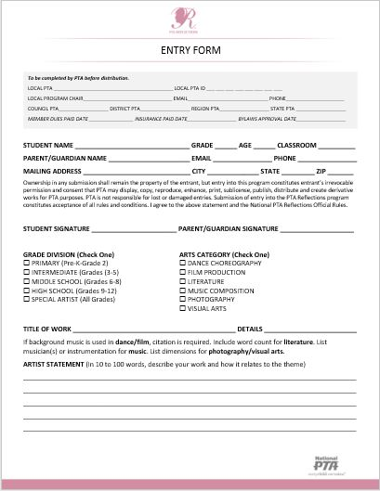
Entry Form
Complete before distribution - >
Student Information - >
Student & Parent Signatures - >
Submission Category & Division - >
Title & Details of Submission - >
Artist Statement - >
Notes:
Shown here, this form is what National PTA uses to collect student information and details around the entries. Please make sure this form is filled out completely and accurately. You can find a fillable version of this form at PTA.org/reflections/startyourprogram.
Make sure to keep a spreadsheet or some collection of all your student entry forms so you can have accurate information for advancing entries and celebrating students.

Slide 10
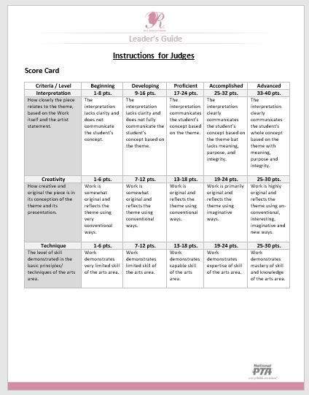
Step 3. Coordinate Judging
Recruit a team of experienced arts judges to review student works
Tap into your local connections and resources
Parents
School/District Administrators
Local Art Professionals
Former participants or judges
Notes:
The biggest advice around judge recruitment is to tap into the resources around you:
Parents: Individuals with art backgrounds may be within or close to your PTA. Make a public call at a PTA meeting specifically for judges.
Administrators: Consider having school or district administrators as celebrity judges to increase notoriety for the program.
Local art professionals like art teachers, artists or art businesses will have connections and will be awesome judges for kids as they learn who is reviewing their work.
Reach out to former judges or Reflections supporters.
Students and arts professors from local colleges and universities may be looking for ways to get involved in their community.
Former Reflections winners like recent High School graduates already know and love the program – recruit them and let them feel like experts themselves!

Slide 11
LAPTA Reflections Timeline
Register your Reflections Program Manager with LAPTA at https://form.jotform.com/231397127809160
LAPTA accepts entries in all six Arts Categories. Each Local PTA Unit can decide which Arts Categories their students can enter.
Arts Categories: Dance Choreography, Literature, Visual Arts, Film Production, Music Composition, and Photography
Eligible Local PTA Units can submit three (3) entries from each Arts Category per Grade Division to LAPTA for judging at the state level. If your school has more than one Grade Division, you may submit three entries for each of those separate divisions.
Grade Divisions:
Primary (Pre-K to Grade 2) Intermediate (Grades 3-5) Middle School (Grades 6-8)
High School (Grades 9-12) Special Artist (All grades)
The Student Entry Portal link will be shared as soon as it is received from National PTA. This is the platform LAPTA use to accept entries. Guidance on how to use the portal will be provided on the LAPTA website.
LOCAL UNIT ENTRY DEADLINE: Monday, January 22, 2024
Local Units must be Actively Affiliated with LAPTA by December 15, 2023, for student entries to be accepted for judging by LAPTA
Notes:
National PTA highly encourages Reflections participants and leaders, of all levels, to let National PTA know about their participation by registering. Registration runs from April 1 Feb. 1 at PTA.org/Reflections. Registering for Reflections helps us show the wide reach of our program and commitment to the arts.
National PTA works alongside non-profit partner Americans for the Arts (AFTA) to celebrate arts in education week and arts in education month. These two celebrations focus on arts in education to recognize and celebrate the positive impact the arts bring to schools and communities as well as the benefits of incorporating the arts and humanities into the lives of students and into school communities. Use these nation-wide events to promote registration and participation in the Reflections program.
Check out our wealth of arts ed resources, including our refreshed Arts Ed Leaders Guide at PTA.org/ArtsEd!

Slide 14
Category and Division Overview
Notes:
State Reflections Chair may adjust rules and processes to cater to the unique needs of your state and state communities.
Local PTAs should implement the program based upon the specific forms, deadlines and guidelines which are required by each State PTA.

Slide 15
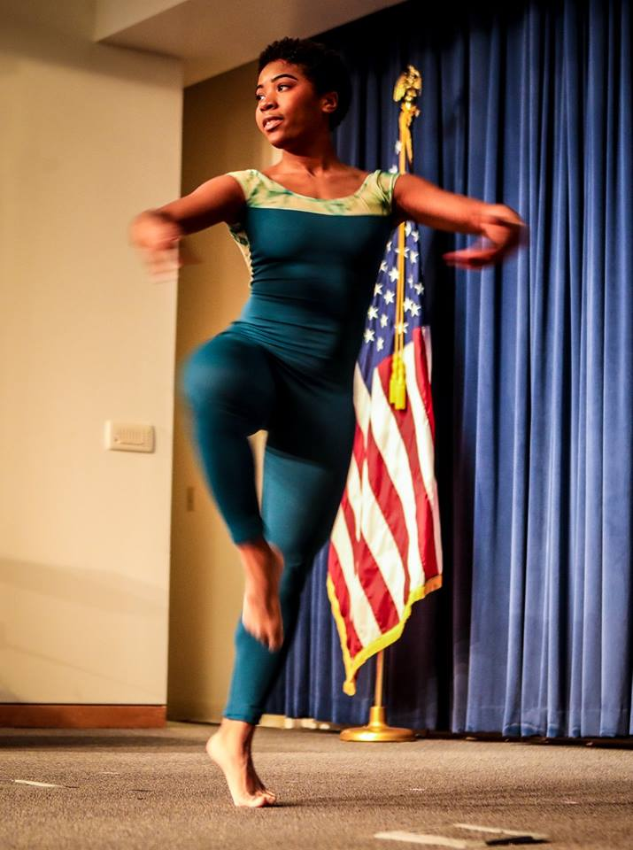
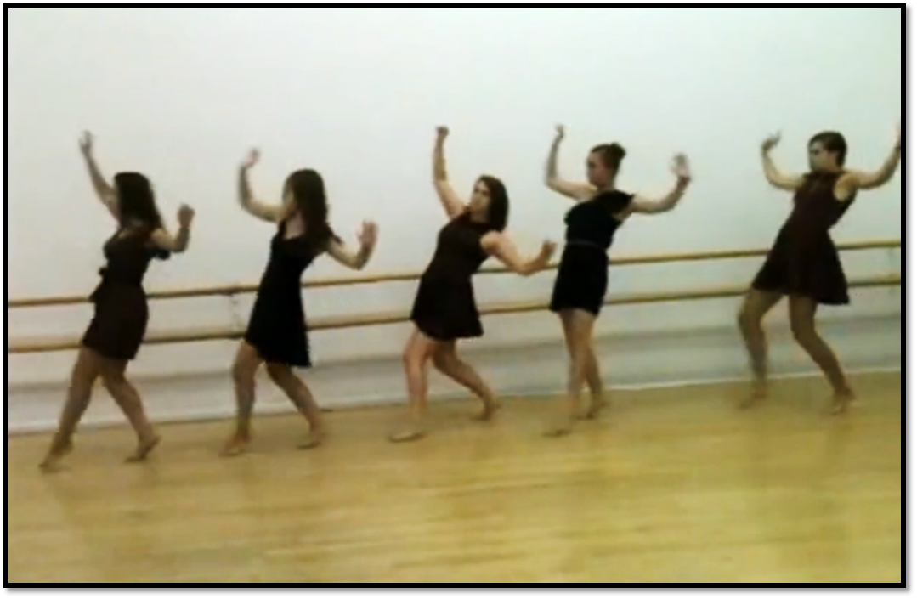
Dance Choreography
Solo and ensemble works of all dance styles are accepted. Entrant must be the choreographer and may also be the performer, or one of the performers. If background music is used, cite it on the entry form.
VIDEO
File must not exceed 5 min. and 1000MB in size
Accepted formats: AVI and MP4

Slide 16
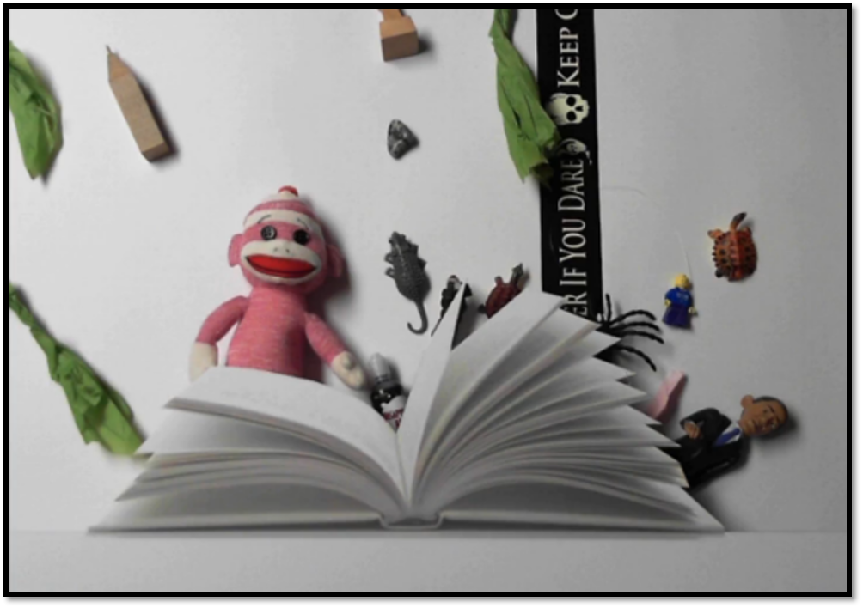
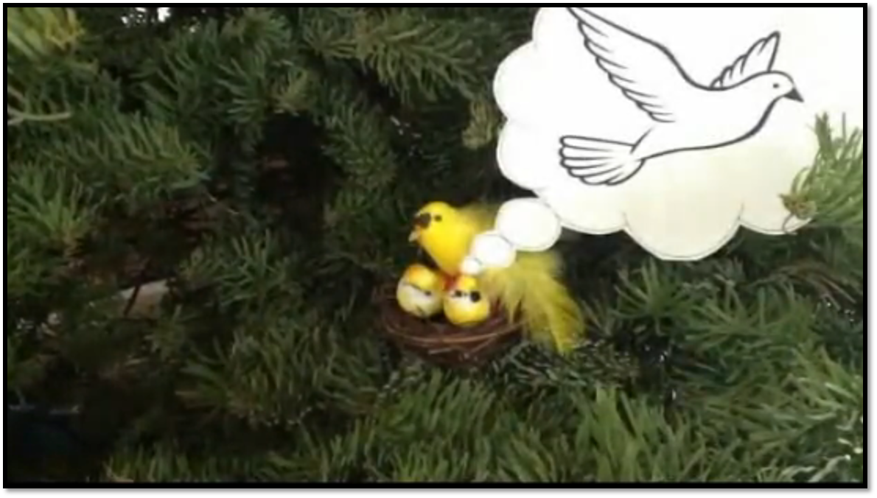
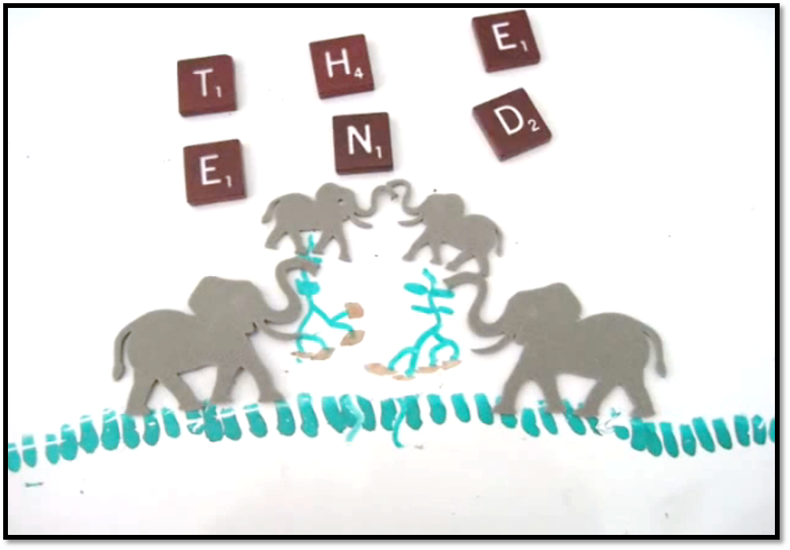
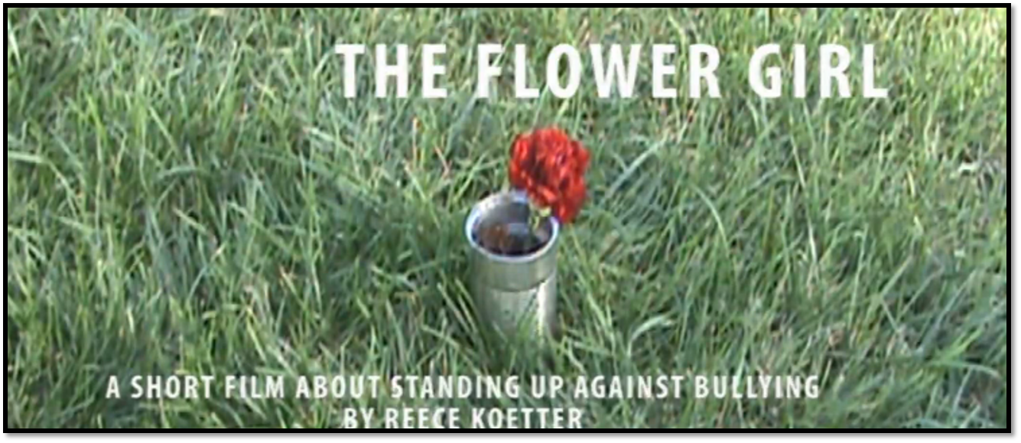
Film Production
Accepted short film styles include: Animation, narrative, documentary, experimental or media presentation. All screenwriting, directing and editing must be done by the student producer. If background music is used, cite it on the entry form.
VIDEO
Video must not exceed 5 min.
File must not exceed 1000MB in size
Accepted formats: AVI and MP4
Use of PowerPoint is prohibited

Slide 17
Literature
Accepted forms of fiction and nonfiction include: Prose, poetry, reflective essay, screen play and play script, narrative, and short story. Entrants may write in their primary language if an interpretive English translation is also attached. Use of copyrighted material is prohibited.
WRITING
Must not exceed 2,000 words
May be handwritten or typed
Single-sided print on 8 ½x11” paper
PDF file

Slide 18
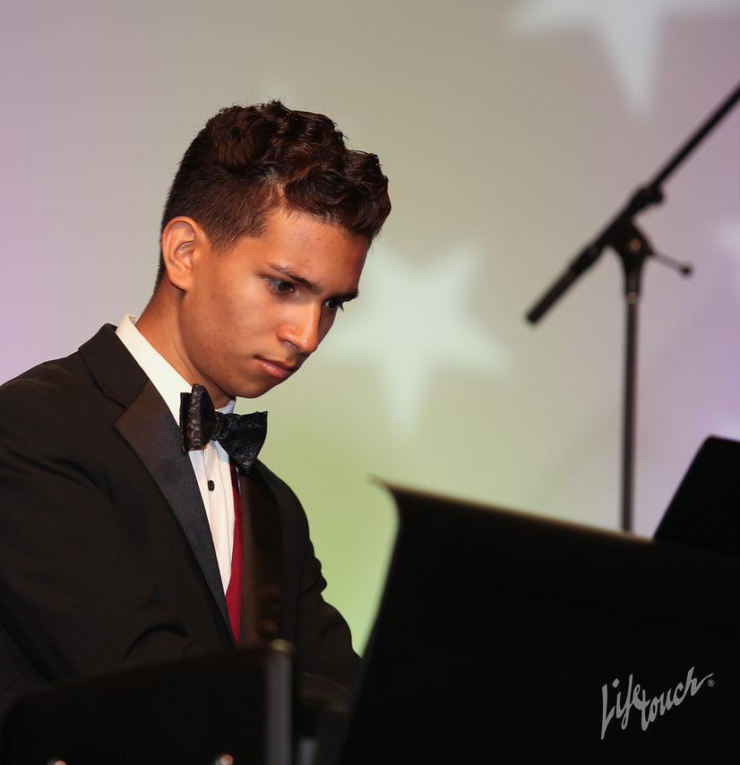
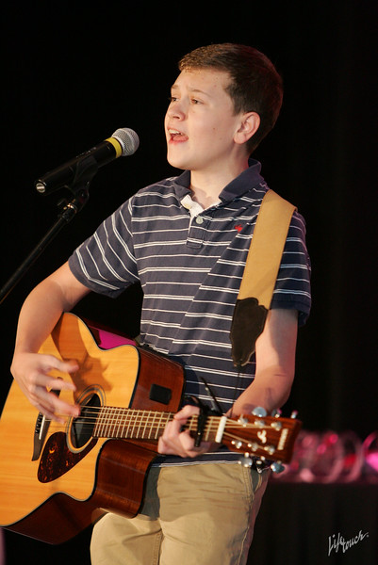
Music Composition
All music styles and combinations of instrumentation are accepted. Entrant must be the composer and may also be the performer, or one of the performers. Use of copyrighted material is prohibited.
AUDIO
File must not exceed 5 min. and 1000MB in size
Accepted formats: MP3 and WAV
NOTATION
Only required for middle and high school divisions
In place of a notated score a written reflective statement that provides a musically technical explanation of how the piece was composed (100 words or less).
Notation in PDF format

Slide 19
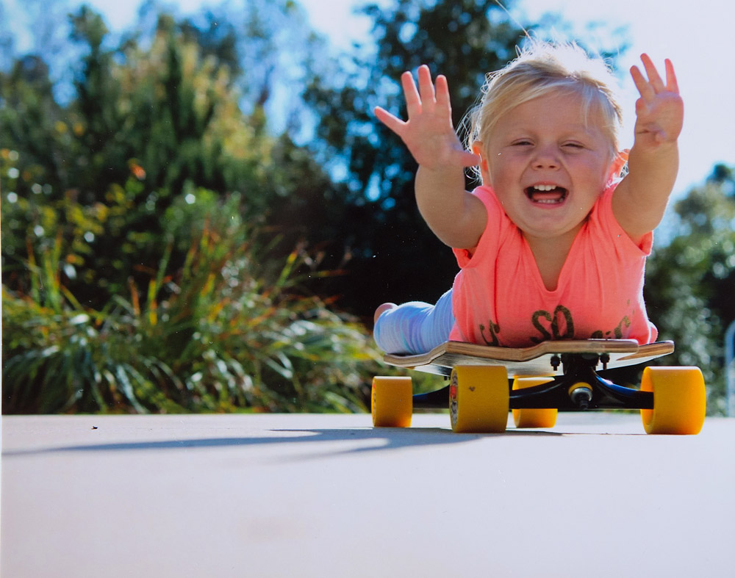
Photography
PRINT
Must be no smaller than 3x5 inches and no larger than 8x10 inches
Accepted print formats: Mounted on mat or poster board no larger than 11x14 inches
Framed prints are not accepted
Include one digital image of artwork with your submission (Accepted file formats: JPEG, JPG, PNG)
DIGITAL IMAGE
Dimensions must be at least 640x960 (pixels) and 300 dpi (resolution)
Accepted file formats: JPEG, JPG, PNG
Photo must be a single print/digital image. Collages and collections of photos are not accepted. Entrant must be the photographer and may use a variety of digital editing techniques including but not limited to, multiple exposure, negative sandwich and photogram.

Slide 20
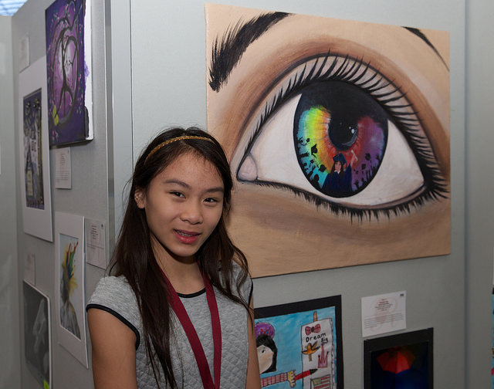
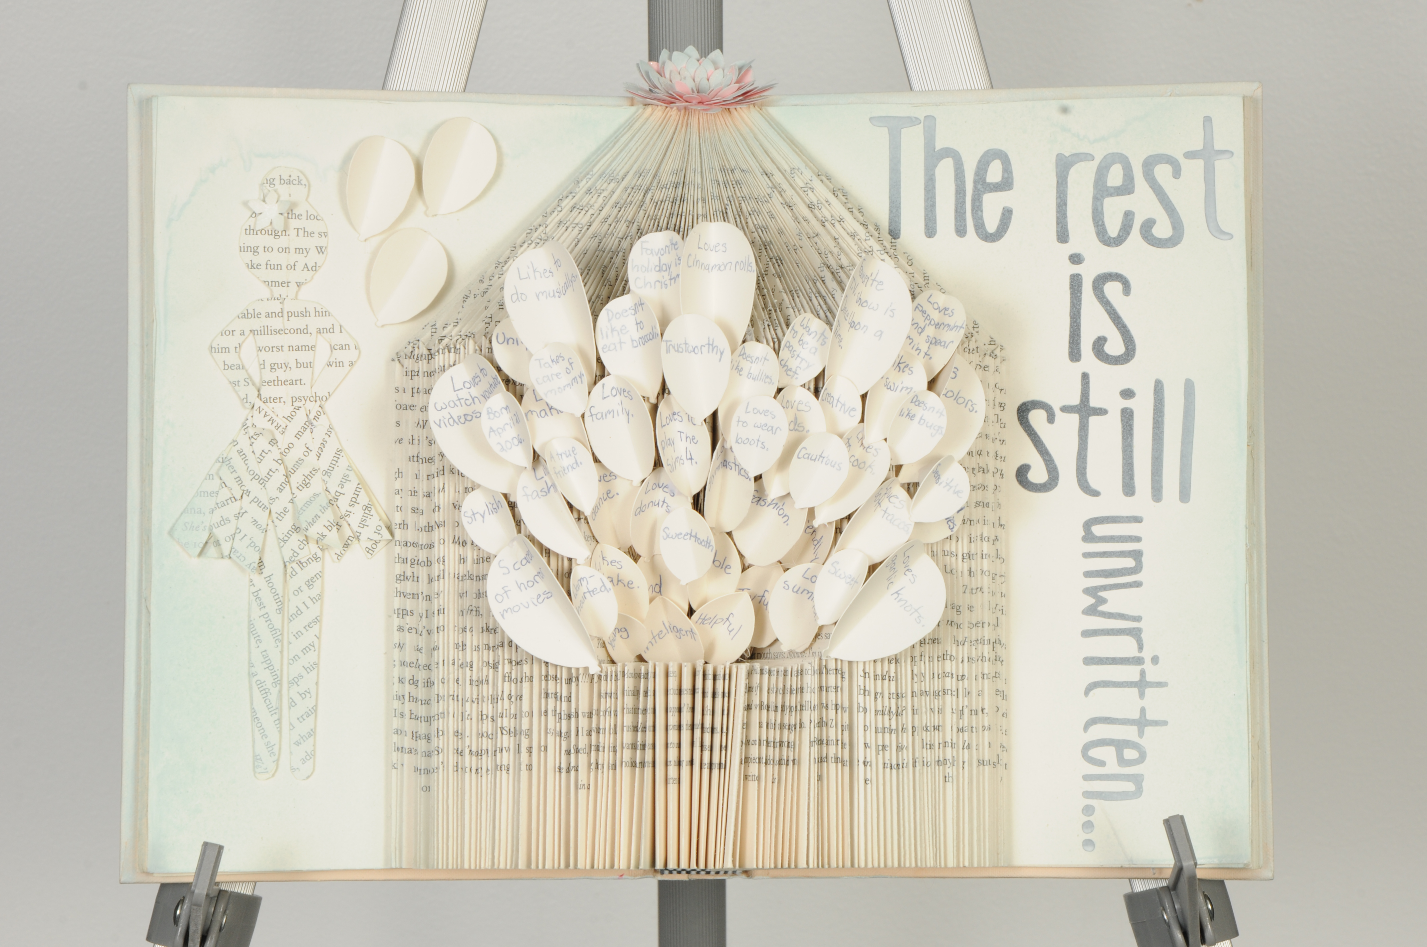
Visual Arts
2D WORKS
Mounted on sturdy material
No larger than 24x30 inches with matting
Framed entries are not accepted
Include one digital image of artwork with your submission (Accepted file formats: JPEG, JPG, PNG)
3D WORKS
Include 3 digital images of artwork at different angles. (Accepted file formats: JPEG, JPG, PNG)
Works of both fine and design arts are accepted, including but not limited to:
architectural drawing and models, ceramics, collage, computer generated images and graphics, crafts, drawing, fashion clothes and jewelry, fiber work, mixed media, painting, printmaking and sculpture.

Slide 21
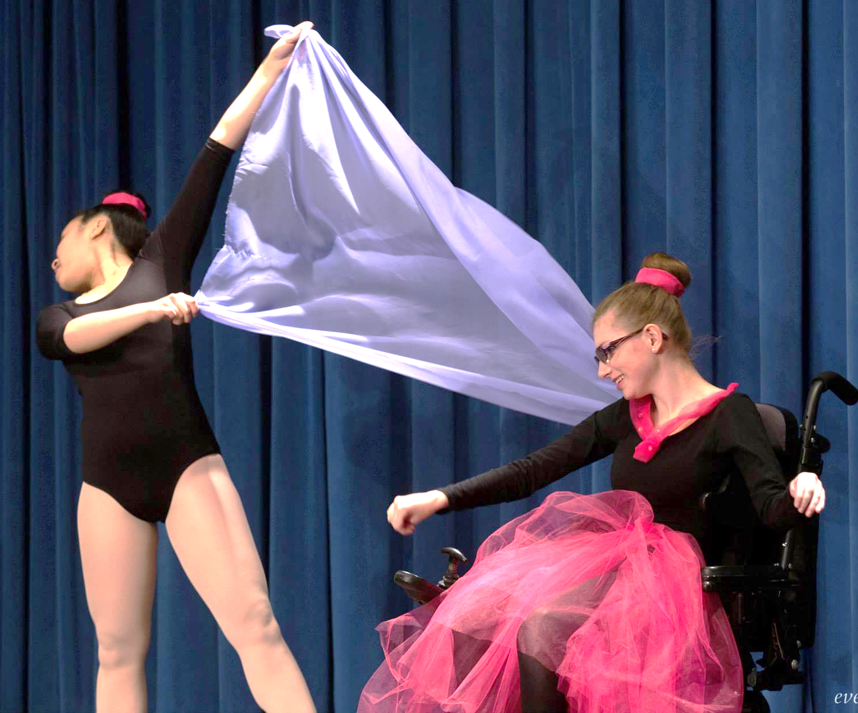
Special Artist Division
Students who identify as having a disability and may receive services under IDEA or ADA: Section 504 may enter in the Special Artist Division OR grade division most closely aligned to their functional abilities.
This Special Artist Division welcomes students from all grades and offers non-artistic accommodations for students to participate fully in PTA Reflections. Student recognition and awards are announced as part of the Special Artist Division.
ACCOMODATIONS
Non-artistic accommodations (e.g. adaptive technology; transcribing; holding a camera)
Assistants must refrain from being involved in the artistic process (e.g. developing an artist statement, choreography, music lyrics, storyboards, etc.)
Notes:
Given the wide array of ability. The Special Artist division allows students to participate in two ways:
Enter the Special Artist Division with art created in one of the 6 categories. All students in this division will compete against one another and will be awarded in this division.
Enter in the grade division that aligns best to their functional capabilities. Students compete against the other students in whatever grade division they choose to participate in.
The special artist division allows students non-artistic accommodations like adaptive technology; transcribing. Those assisting the student entrant must refrain from being involved in the artistic process (e.g. developing an artist statement, choreography, music lyrics, storyboards, etc.)

Slide 22
Step 4. Advancing and Celebrating Your Students
Assign awards by category and division
Advance finalists to the next level according to LAPTA guidelines and deadlines
Celebrate your students:
Announce winners on school websites and social media and tag @NationalPTA and #PTAReflections
Offer awards from ShopPTA.com and donated prizes from community supporters
Host a student recognition event for families
Showcase student works at school and in the community
Notes:
When assigning awards remember to advance entries to the next level of review according to your state requirements. There may be specific requirements, deadlines, or rules that you will need to know to successfully advance the entries.
Once this is done – its time to celebrate! There are many ways that Local PTAs, celebrate Reflections participants and winners in their communities. Some examples include school awards nights, exhibits at community arts galleries or other public spaces and features in local newspapers or television broadcasts.
Consider using the acknowledgement letter at PTA.org/StateReflectionsLibrary to thank students and parent leaders, school personnel, submission reviewers and community businesses for their support. Share links to student winner announcements and invite volunteers to Reflections celebration events – even if they do not attend, the invite will show your appreciation and allow you to maintain the relationship into the future. Thank you emails also offer a way to provide updates and keep volunteers informed on the program process and next steps.
To increase visibility and support of the Reflections Program, promote the celebrations happening across your school community! Use your social media channels such as Twitter or Facebook to share artwork and family photos, links, quotes or anecdotes from these events. Use the template media advisory and press release to make it easier for you to promote awards and events.
And remember to tag National PTA using #PTAReflections and @National PTA.

Slide 23
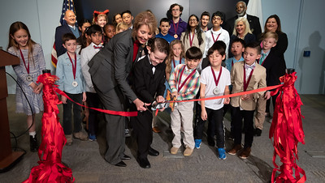
National PTA Awards and Exhibits
Student Arts Showcase and Exhibit January
National Winners Announcement May 1 PTA.org/Reflections Celebration Event and Exhibit Annual National PTA Convention
Notes:
Remember - you won’t be celebrating alone! Each year National PTA celebrates Reflections artists and artwork – save the date and stay connected on social media @NationalPTA and #PTAReflections.

Slide 24
Don’t Forget to Wrap Up!
Make sure to thank student and parent leaders, school personnel, submission reviewers and community businesses for their support
Return non-advancing works and contact students who are advancing in the competition
Host a debrief with your volunteers committee
Record notes and contacts for next year’s Reflections Chair
Notes:
While this isn’t required a full Reflections wrap up it is highly recommended that you conduct a full wrap up of your Reflections program.
Contact all students who had entries advance. Those involved are eager to hear about their status. If you hold onto student artwork for an exhibit, let them know in case they need their artwork for something else (e.g., college portfolios, other competitions).
Meet with your Reflections Committee and other team members to reflect on the program, gather feedback and document successes and areas needing improvement. The Local Leader Guide found at PTA.org/Reflections/StartYourProgram contains a sample program evaluation. Make sure to share the information gathered with your school community. Highlight the impact of the program to continue program involvement and support in your community.
Record notes after completing the wrap up process to make sure next year’s team will have a reference point. Sharing this information will provide a smooth transition from one Reflections Chair to the next.

Slide 25
Questions? Send a note to arts.education@louisianapta.org

