Slide 1
PTA Leadership Training PTA Leadership Training Membership
Hosted by Louisiana PTA
LouisianaPTA.org/membership
Membership@LouisianaPTA.org

Slide 2
Why are we here? Why do you PTA?
To make every child’s potential a reality
by engaging and empowering families and communities
to advocate for all children.

Slide 3
Objectives today:
Become aware of LAPTA Officer and Unit requirements
Review the duties of the Membership VP/Chair and committee members
Learn about Membership Campaigns
Define the Value of PTA – how to create a PTA Value Message
Learn about the LAPTA Monthly Membership Challenges and Annual Awards
Become aware of the LAPTA Communications and Social Media Guidance memo
LouisianaPTA.org/membership

Slide 4
Where to start? With Sign-Ups & Downloads
Register at LouisianaPTA.org/submit-officer-data-1. This is required and will allow you to receive LAPTA emails and e-newsletters.
Visit LouisianaPTA.org/membership
Download the LAPTA Toolkit: Membership Sec 6. The Toolkit contains information on your job
Create an account at PTA.org and create an account. There is lots of information plus e-Learning and “Thrive” educational videos.
Reminder: all officers need to be PTA members of their Local PTA Units -- this also makes you a LAPTA and National PTA member.
LouisianaPTA.org/membership

Slide 5
Why do membership numbers matter?
A growing and engaged membership is the foundation for achieving PTA's mission to make every child's potential a reality.
PTA stands for every child, one voice. Members represent and speak for every child.
Growing membership is the responsibility of everyone on your board.
There is strength in numbers – one person CAN make a difference and a room full of people can make CHANGES!
LouisianaPTA.org/membership

Slide 6
Basic Roles and responsibilities of the Membership VP/Chair
You are a member of the Executive Committee (if a VP) and/or the Board of Directors.
Your basic duties are defined in the LAPTA Membership Toolkit, Section 6, page 10.
Your additional duties may be designated in your unit standing rules.
You chair the committee to help plan, recruit, and recognize members.
You are familiar with and use the National PTA Membership Campaigns and Messaging tools available at https://www.pta.org/home/run-your-pta/membership-resourcespta.org
LouisianaPTA.org/membership

Slide 7
Roles and Responsibilities, cont’d:
You regularly submit dues and membership rosters at https://www.louisianapta.org/submit-dues encourage your unit to participate in the LAPTA membership contests
You provide the Executive Committee the most current membership roster monthly.
You provide repeated opportunities for people to join your PTA throughout the year.
You thank all your members for joining.
You celebrate your membership successes!
LouisianaPTA.org/membership

Slide 8
PTA dues directly support your child. PTA dues support advocacy efforts at the local, state and national levels, impacting decisions affecting your child’s health, safety and quality of education. PTA dues support our work to strengthen connections between your family, your child’s classmates and their families, and teachers to build a thriving and inclusive community for everyone.
Membership Dues – What Do They Provide
All PTA leaders and members are volunteers, from the individual school unit up to the national level. The dues you remit from your PTA go to pay for shared statewide and national resources (program development, social media, websites, printed materials, training events, etc.), operational expenses, and reimbursements for travel expenses to trainings and to participate in conferences to benefit the association.
LouisianaPTA.org/membership

Slide 9
Submitting Membership Dues
The first step to processing memberships is to go to LouisianaPTA.org/submit-dues.
Click “PAYMENT LINK” which brings you to CheddarUp.com. The system will accept an eCheck.
Submit the number of individual memberships collected by the PTA. The cost is $3.50 each. Local Units must have a minimum of 30 members to maintain Active Affiliation with LAPTA each year.
The exact number of memberships collected from your members must be submitted. It is important to properly account for all members. National PTA collects the dues portion of $2.25 per member dependent on the membership numbers submitted by LAPTA by the 5th of each month.
LouisianaPTA.org/membership

Slide 10
Submitting Membership Reports
Download the Excel spreadsheet called “LAPTA Local PTA Membership Report” by going online to LouisianaPTA.org/membership. This is the format used for Membership Reports. See right.
Rename the file with the [PTA name] Member Report [date]. In the spreadsheet, enter the information in the top section and then last name, first name, and email for every member into the spreadsheet. After submitting dues, email the Membership Report to office@LouisianaPTA.org.
Repeat the process above monthly. Memberships are good for one year, expiring on June 30.
Send out a thank you note to all members by email or paper note at least monthly.
Include LouisianaPTA.org and PTA.org in your correspondence for members to check out.
LAPTA LOCAL UNIT MEMBERSHIP REPORT 2022-23
After submitting dues, email this Member Report to office@LouisianaPTA.org.
PTA Name: |  |  | Today's Date:
School Name: |  |  | School's Student Count:
School City: |  |  | School's Teacher/Admin Count:
School Parish: |  |  | Your PTA's Membership Goal:
Your Name: |  |  | Total Memberships Year to Date:
Your Email: |  |  | New Memberships for this Report:
Member Last Name |  | First Name | Email Address
Last |  | First | Email
Last |  | First | Email
Last |  | First | Email
Last |  | First | Email
LouisianaPTA.org/membership

Slide 11
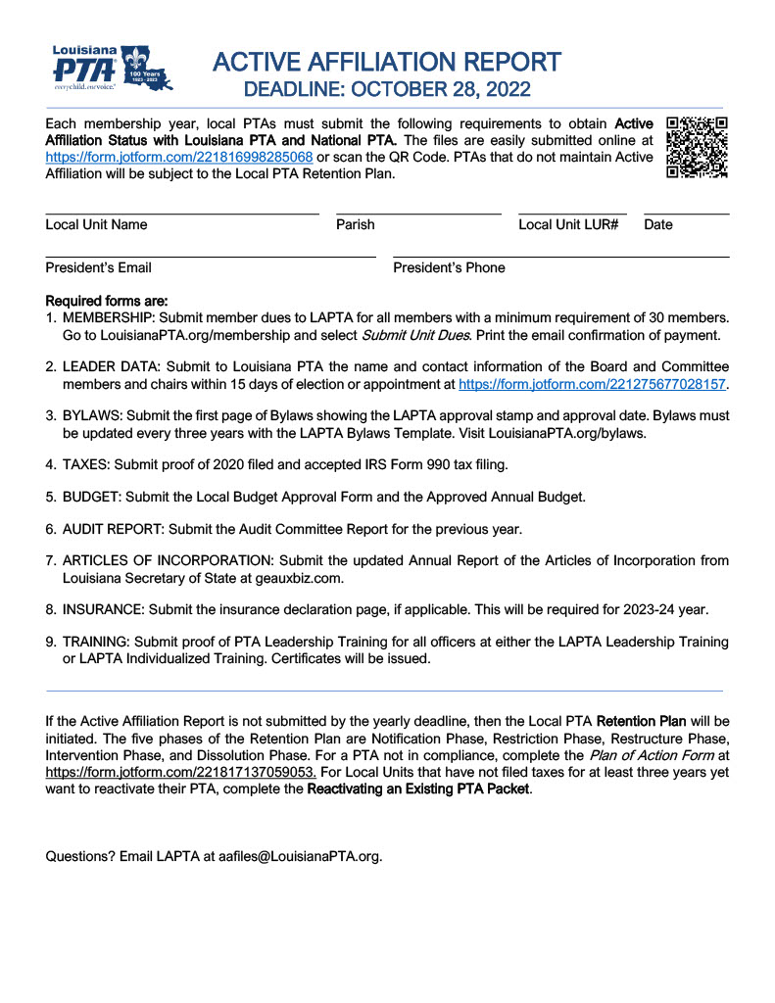
Active Affiliation
All local units in Louisiana have mandatory annual requirements that need to be documented and submitted to LAPTA in order to continue operating as a PTA through the Active Affiliation Files.
A unit must be in" Active Affiliation" to be eligible for awards, grants, contests, and student participation in LAPTA and National PTA judged programs like Reflections.
Membership dues are a requirement of Active Affiliation. As the Membership VP/Chair you are responsible for ensuring membership dues are submitted
Go to https://www.louisianapta.org/activeaffiliation for more information on Active Affiliation and to review the submission process
LouisianaPTA.org/membership

Slide 12
So, Let’s Grow our PTA Family
Do you know the number one reason why people say that they haven’t yet joined PTA?
They were never asked to join!
You know the good work that your PTA does for your community every day but talking about that good work and asking others to join can be hard.
National PTA has provided tools and resources to help make your work easier.
The membership campaign—PTA For Your Child—is designed to engage and excite new members and existing members by making the work of the PTA more visible and highlighting the value and impact of PTA.
LouisianaPTA.org/membership

Slide 13
Let’s Check out the “PTA For Your Child” Campaign
https://youtu.be/vG74RpvbGas
Membership Campaign materials include:
Downloadable Toolkit
Written communications to help facilitate your campaign
Lots of campaign visuals in English and Spanish that you can customize
Online training at https://www.pta.org/home/run-your-pta/membership-resources/membership-campaign
LouisianaPTA.org/membership

Slide 14
Let National PTA show you how to start a conversation with anyone to let them know why they should join your PTA
The Reasons YOU Belong Value message tools include:
The Guide: Five Easy Steps
Social Media Graphics
Print & Go Flyers
Customizable Content Flyers
LouisianaPTA.org/membership

Slide 15
Let the Guide help you to create a PTA Value Message
Understand your audience and their needs
Review the three high value areas as a starting point
Value 1: Our PTA/PTSA creates connections
Value 2: Our PTA/PTSA supports your child
Value 3: Our PTA/PTSA amplifies your voice
Identify your audience – which Value item appeals most to them?
Answer three key questions
Why join PTA/PTSA?
In what way does PTA help me?
How do those ways benefit me and my child?
LouisianaPTA.org/membership

Slide 16
When planning your membership recruitment efforts, keep this slogan in mind:
PTA believes that together we can make every child’s potential a reality—but we need more believers like YOU. We need YOU. Will you join us?
You can find the guide and everything you need at:
https://www.pta.org/home/run-your-pta/membership-resources/reasons-you-belong
LouisianaPTA.org/membership

Slide 17
LAPTA Monthly Membership Challenges
LAPTA has a goal of 12,100 members for our 100th year in 2022-23, and we need our Local PTA Units to help us reach that goal.
To be eligible for awards, PTAs must have Active Affiliation status. The monthly challenges will be automatically determined by LAPTA.
All qualifying PTAs will receive a certificate and put into a monthly drawing for $100 gift to the PTA.
August
Early Bird Award
Submit 25 members by August 31 plus Officer Data at LouisianaPTA.org/submit-officer-data-1
September
Membership Head Start Award
Jump start the PTA with 50% or more of the previous year’s PTA membership by September 30
LouisianaPTA.org/membership

Slide 18
LAPTA Monthly Membership Challenges, cont’d:
November
Geaux PTA Award
Achieve more than 100% of the previous year’s PTA membership
and completed Active Affiliation Packet by November 30
December
Lagniappe Award
Achieve 125% of the previous year’s membership and completed
Active Affiliation packet by December 31
January
Welcome Back Award
Keep up the momentum with ten new members by January 31
February
Founders’ Day Membership Challenge
In honor of our PTA Founders on February 17, add 17 new members
by Feb 28
LouisianaPTA.org/membership

Slide 19
LAPTA Annual Membership Awards
Annual membership awards will be announced at the General Membership Meeting on
March 25, 2023. Membership rosters must be submitted by March 15 to office@LouisianaPTA.org in order to compete. Go tohttps://www.louisianapta.org/awards
Super Grower
Greatest increase from previous year
Membership Marvel Award
Increased membership by 10% over the previous year
Golden Apple Award
100% membership of teachers and administrators
Platinum: One Voice for Every Child Award
Recruit members equal to 100% of student enrollment
Gold: One Voice for Every Child Award
Recruit members equal to 75% of student enrollment
Silver: One Voice for Every Child Award
Recruit members equal to 50% of student enrollment
LouisianaPTA.org/membership

Slide 20
Membership Binder
Create a Membership Binder. Suggested sections:
Tab 1: Summary of PTA accounts and passwords and the Board roster.
Tab 2: LAPTA Toolkit: Membership, Section 6, plus sections 1 (Office &PTA Basics), 5 (Board of Directors), and 10 (Bylaws, Standing Rules & Articles of Incorporation)
Tab 3: Membership Reports and Rosters spreadsheets, reports, notes, email campaigns, Welcome Packet, and other membership materials
Tab 4: Agendas and Minutes
Tab 5: Notes, email campaigns, Welcome Packet, and other membership materials
Tab 6: Deposit Forms and Expense Forms from the Treasurer
Tab 7: Other
LouisianaPTA.org/membership

Slide 21
Communications & Social Media
More assistance is available at:
https://www.pta.org/local-leader-kit/communications
National PTA shares tips and best practices to effectively share messages with fellow PTA members, school staff and administrators, community members, and the media.
LouisianaPTA.org/membership

Slide 22
Communications & Social Media
Communicate to share the
good work of PTA
Newsletters
Website
Social media platforms
LouisianaPTA.org/membership

Slide 23
Review – today you have covered:
LAPTA Officer and Unit requirements
Basic roles and responsibilities of a Membership VP/Chair
Been introduced to National PTAs Membership Tools and Resources
Reviewed the LAPTA Dues Submission Process and Membership Reporting Requirements
The LAPTA Monthly Membership Challenges and Annual Awards
The LAPTA Communications and Social Media Guidance memo
LouisianaPTA.org/membership

Slide 24
Any questions?
One Last thing ………
LouisianaPTA.org/membership

Slide 25
LAPTA is in search of a Membership VP to serve on the Board of Directors
Apply here!
Email us at president@louisianapta.org if you are interested in learning more about volunteering at the state level
LouisianaPTA.org/membership

