Slide 1

PTA Leadership Training
Diversity & Inclusion Workshop
Hosted by Louisiana PTA
LouisianaPTA.org
Dia Young, National PTA DEI Committee Member
Notes:
[WELCOME]
I am proud and excited to present this workshop on behalf of the National PTA. Thank you for taking your time to come to this session.
Name Dianira Young (Call me Dia)
where you are from From McAllen Tx and moved to Slidell after Hurricane Katrina for business.
how long you have been engaged in PTA I have been involved with PTA since 2010. I started at CCE (insert story), and Moved to Mayfield Elem, SJH, SHS. But I did District PTA for 4 years and State PTA for 2 ½ years. National PTA for a year.
PTA/other positions I have been a Reflections Chair, Treasurer, Vice President, President at 2 schools, and a lot of subcommittees.
Raise your hand if are:
Unit leader/committee member
State leader
Member looking to become a PTA leader/ Other - invite sharing
[CLICK TO NEXT SLIDE]

Slide 2

Why are we here?
Why do you PTA?
To make every child’s potential a reality
by engaging and empowering families and communities
to advocate for all children.
LouisianaPTA.org
Notes:
[DESCRIBE MISSION]
That everlasting flame is our vision and mission to make every child’s potential a reality by engaging and empowering families and communities to advocate for all children.
Since February 17, 1897 when more than 2,000 concerned parents, educators, and community leaders came together for the first time and created the PTA. The people assembled with incredibly diverse perspectives but they had one incredible cause: our kids.
Describe in your own words why this mission matters so much to you.
Ask others in the audience to share why they care so much about what we do.
[CLICK TO NEXT SLIDE]

Slide 3
Workshop Learning Objectives
Explore the meanings of diversity and inclusion
Understand why building a diverse and inclusive PTA is important
Assess your PTA’s diversity and identify ways to be more inclusive
LouisianaPTA.org
Notes:
By the end of this workshop, you will be able to:
Explore the meanings of diversity and inclusion: We will talk about how diversity is one piece of the puzzle. Inclusion is key to making each person feels valued, welcome, and comfortable.
Understanding why building a diverse PTA is important – You’ll understand why this is a national, state and local priority.
Assess your PTA’s diversity and identify ways to be more inclusive – We will explore ways to assess your PTA’s diversity and brainstorm specific strategies that you can use for to be more inclusive. Each of you will walk away with the beginning of a plan that you can work with your PTA board to complete.
[CLICK TO NEXT SLIDE]

Slide 4

Think. Pair. Share.
What does diversity mean to you?
LouisianaPTA.org
Notes:
Step 1: Take a moment to think about what diversity means to you.
Step 2: Pair up with a neighbor and share your definition with each other. Are there similarities? Are there any differences?
Step 3: Write a shared definition of diversity.
Step 4: Report out to the group at large.
[LARGE GROUP DISCUSSION]
Facilitate a dialogue about the definition. Use flip chart (if available) to generate commonalities in messaging.
[CLICK TO NEXT SLIDE]

Slide 5

Behaviors
Language
Actions
Race
Gender
Style
Age
Physical Abilities
Values
Life Experiences
Perspectives
Thoughts
Sexual Orientation
Religion
Culture
Source: Hugh Molotosi
LouisianaPTA.org
Notes:
[SELF REFLECTION]
Take a minute to study this slide.
[LARGE GROUP DISCUSSION]
Who wants to share what you see here?
What are your key takeaways?
Do you feel like anything is missing?
Summarize key points:
Diversity is deeper than the tip of the iceberg of a person and seeing the many layers of a person’s perspective.
Race, language and gender are very important factors that may influence a perspective because people often judge others and make assumptions based on what they can see about you. They observe you and think they know what you are about. But the reality is – there are so many more factors that define your point of view, your behaviors and your actions.
[CLICK TO NEXT SLIDE]

Slide 6

What Is Diversity?
  Diversity is differences in racial and ethnic, socioeconomic, geographic, and academic/professional backgrounds. People with different opinions, backgrounds (degrees and social experience), religious beliefs, political beliefs, sexual orientations, heritage, and life experience.
The Mix
LouisianaPTA.org
Notes:
Diversity is differences in racial and ethnic, socioeconomic, geographic, and academic/professional backgrounds. People with different opinions, backgrounds (degrees and social experience), religious beliefs, political beliefs, sexual orientations, heritage, and life experience.
Just as you see in this cake ingrediencies

Slide 7


What Is Inclusion?
Inclusion involves bringing together and harnessing diverse forces and resources in a way that is beneficial. Inclusion puts the concept and practice of diversity into action by creating an environment of involvement, respect, and connection—where the richness of ideas, backgrounds, and perspectives are harnessed to create business value and overall success.
Inclusion: “Making the Mix Work”
LouisianaPTA.org
Notes:
Inclusion involves bringing together and harnessing diverse forces and resources in a way that is beneficial. Inclusion puts the concept and practice of diversity into action by creating an environment of involvement, respect, and connection—where the richness of ideas, backgrounds, and perspectives are harnessed to create business value and overall success.
Just as you see here in the beautiful cake that was made from those ingrediencies (diverse outlooks)

Slide 8
LET’S PLAY:
Diversity & Inclusion BINGO
Review form and think about what’s true for you
Start 5-minute timer
Ask others to initial their truths on your Bingo card and vice versa
Person with most signatures wins
LouisianaPTA.org
Notes:
Think about your own diversity for a minute as we prep to have some fun bringing our own glaciers to life through a fun game we call…
Step 1. Distribute required handout: BINGO CARDS
Step 2. Take 5 minutes to find as many people as you can to sign your boxes. No rules – you can sign one card multiple times! Just have fun getting to know each other. The goal is to get as many boxes signed as you can!
Step. 3. Call time at 5 minutes. Ask who got more than 10 boxes? 15? 20 – go on until you identify the person(s) with the highest number of boxes. Was there any box the audience had a hard time filling? Is there a box we didn’t fill in this room?
[FACILITATE LARGE GROUP DISCUSSION]
Share some of who YOU are on this list as a transition to facilitating a dialogue about the experience.
Ask about the experience of sharing what you can see – and what you can’t see about yourself. Was it comfortable? Uncomfortable?
How did you feel when you found someone who had something in common with you that you didn’t expect? Or something you didn’t know about a person you thought you knew well?
Did you notice anything about the questions asked? What did you learn about diversity?
Summarize key points:
Often when people focus on diversity, they focus on the things that can be seen – or the differences among us. The point is – we’re all different in many ways. That’s what makes us exciting as a collective group. It’s important to respect our differences, yet acknowledge shared interests that unite us. No one person will feel exactly the way you do about any given topic. Nor will they bring the same exact strengths to the table. You can’t generalize what a person will feel or how they will respond based on one perspective they have. No one box on the Bingo card defines you.
Having a diverse PTA means – you reflect the kids and families you serve in terms of what you can see – but also in terms of lived experience. Your PTA knows what kids struggle with, what families of your school or community need, and what ways we can focus PTA’s efforts on supporting student success and overall being. Being inclusive means – you welcome all of the diverse perspectives and all families feel motivated to not just be present at PTA events – but be part of PTA as members and leaders. Being inclusive means you value the differences of the people who make up your membership and you leverage the variety of their strengths to address meaningful priorities that represent the concerns of your community.
We know that anyone who joins PTA – who wants to support or help your PTA – starts with the same fire in their heart as you – they want what’s best for our kids.
It’s the fire that has been fueling PTA for 125 years since we were founded with the mission of…
[CLICK TO NEXT SLIDE]

Slide 9
Ways to Achieve Diversity & Be More Inclusive
Reflect on whether your membership and board leadership represents the many perspectives of families you serve and recruit accordingly
Distribute a survey or host listening sessions and share what you heard
Examine what you do to see if your PTA is focused on what families and educators care about most:
  Communications tactics
  Events and programs
  Advocacy efforts to support student success or improve the school
LouisianaPTA.org
Notes:
Other Ways to Assess Diversity & Inclusion:
ANIMATION: Reflect on whether your membership and board leadership represents the many perspectives of families you serve and recruit accordingly
ANIMATION: Distribute a survey or host listening sessions. You can reach out one-on-one to as many different perspectives as you can. Or ask your board members to canvas their neighborhoods or connections. Anyone want to share what they’ve done?
ANIMATION: Fundraising -- Are you purposeful in raising money? Do you make sure it isn’t an unintentional barrier for PTA involvement? Are you transparent in how funds will improve the school? Do you translate info?
ANIMATION: Examine existing communications strategies, events, programs, advocacy efforts – is your PTA focused on what families and educators care about most?
Listening can inform:
Program attendance (Affordable, convenient time/location, welcoming environment, food, translators, important topics or fun)
Board/Volunteer participation (Welcoming, child care, convenient times/locations, strengths-focused?)
Membership form (Do you provide options for joining including no-time commitment or no fee options?)
[CLICK TO NEXT SLIDE]

Slide 10
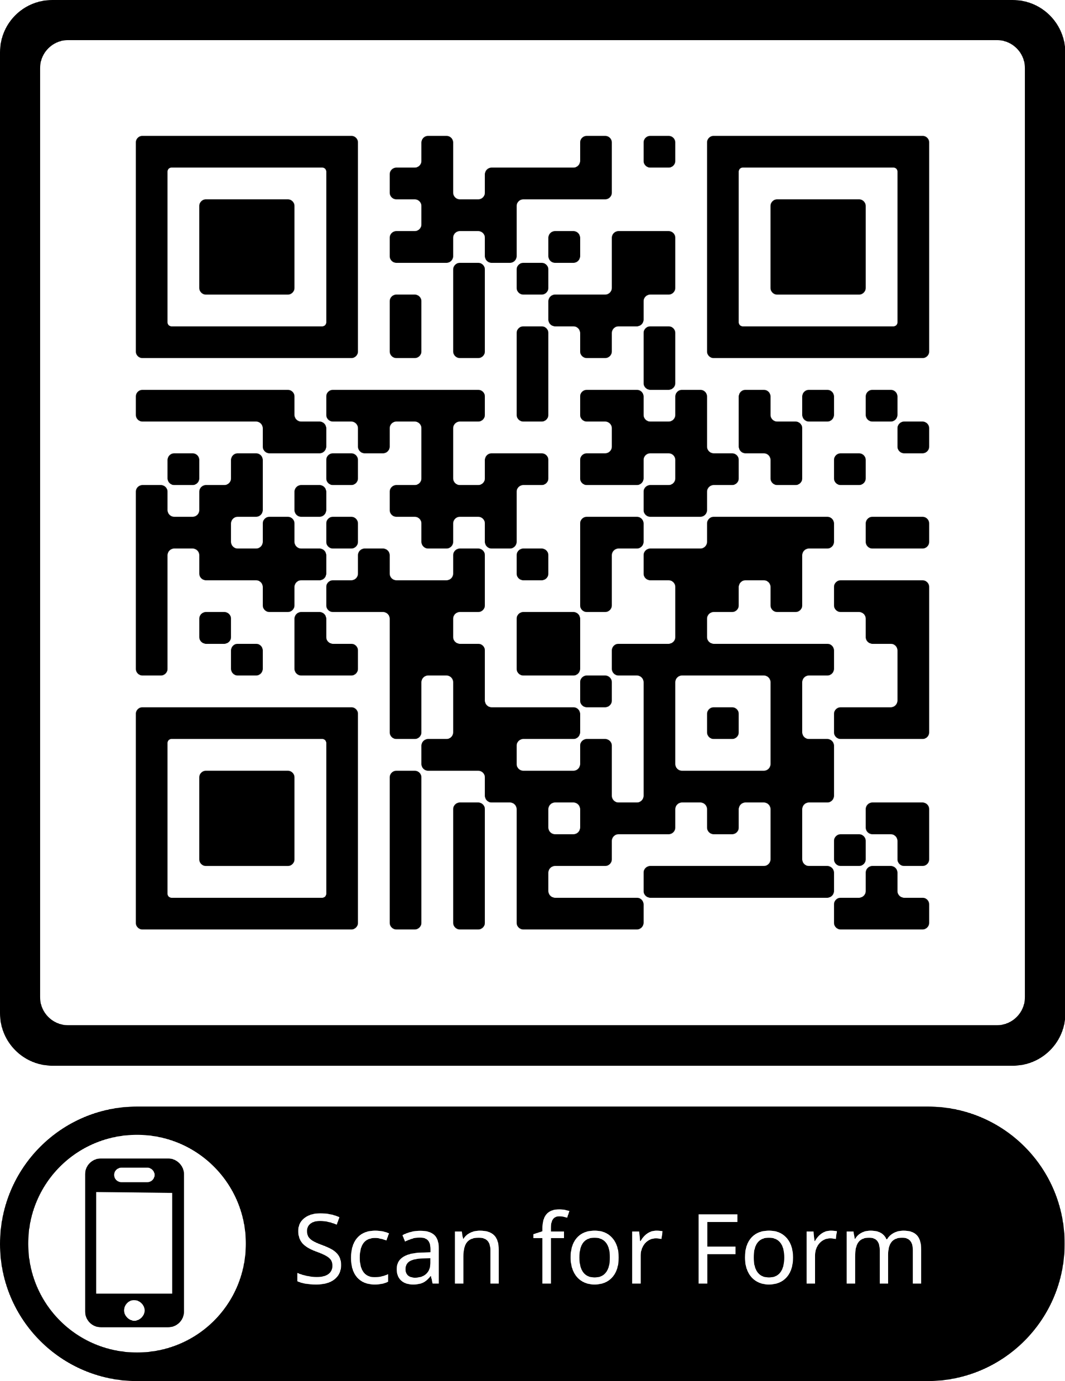
What/who should your DEI Chair advocate for?
To be one voice for every child, our PTAs must see the needs of every child in our schools.
Complete National PTA Diversity Profile Template to learn your local:
  Racial demographics
  Socioeconomic status
  Physical or learning differences
  Religion
  Family structures
  LGBTQ+ Community
  Age ranges, Gender, Geography
LouisianaPTA.org
Notes:
[DISTRIBUTE HANDOUT]
The first step of your diversity and inclusion plan is to assess where you are – who are your members, your leaders and are they reflective of the diverse perspectives in your community? What do the members of your school or community care about?
We’ve developed this template planning tool to help you gather more info about who your families are, what they care about all in one place.
Check out GreatSchools.org to gather important facts. Remember these are only the tip of the iceberg. To be inclusive, seek to understand more about the families and students you serve. Ask, survey and LISTEN. Value different perspectives. Share your power and invite others to lead.
It’s not easy to listen and assess. In fact it’s difficult and sometimes disappointing because you work so hard – you just want everything to look/feel great!
There is a reason we take “selfies.” Because we have control of the angle of the camera. We know which angle looks best. With this exercise, you need to hand over the camera and let others share what they think could be better. Be vulnerable and willing to listen. Be willing to adjust - we call it PTA Flexible! Learn from what you hear – perception always has some reality.
[CLICK TO NEXT SLIDE]

Slide 11
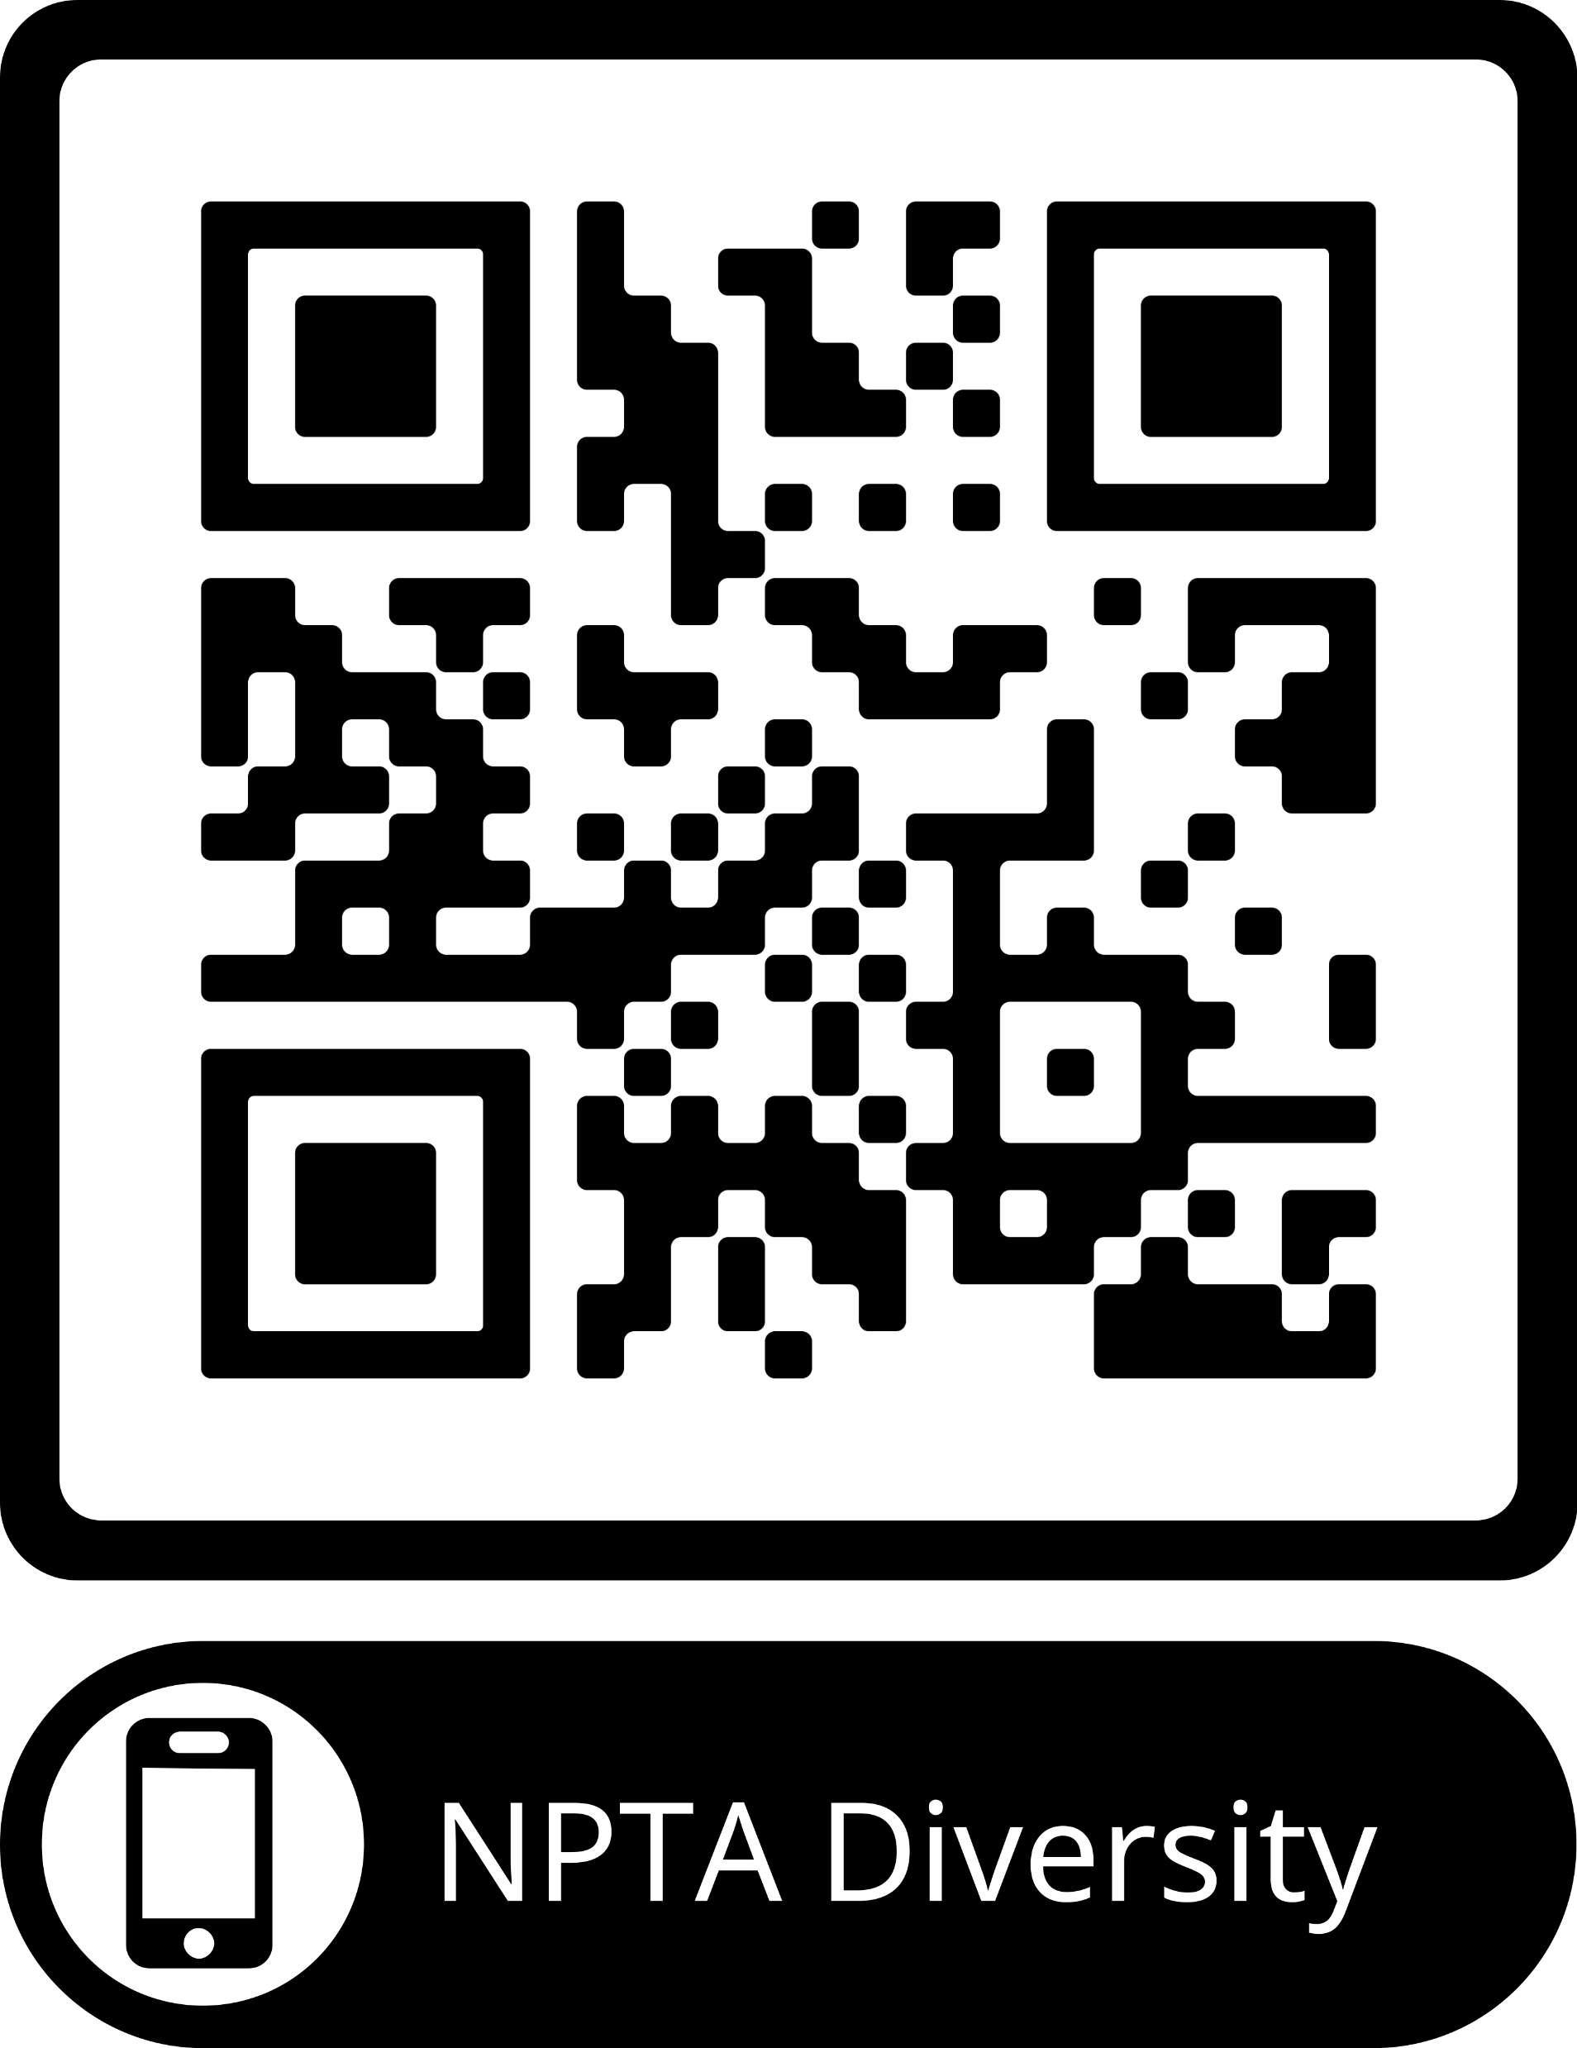
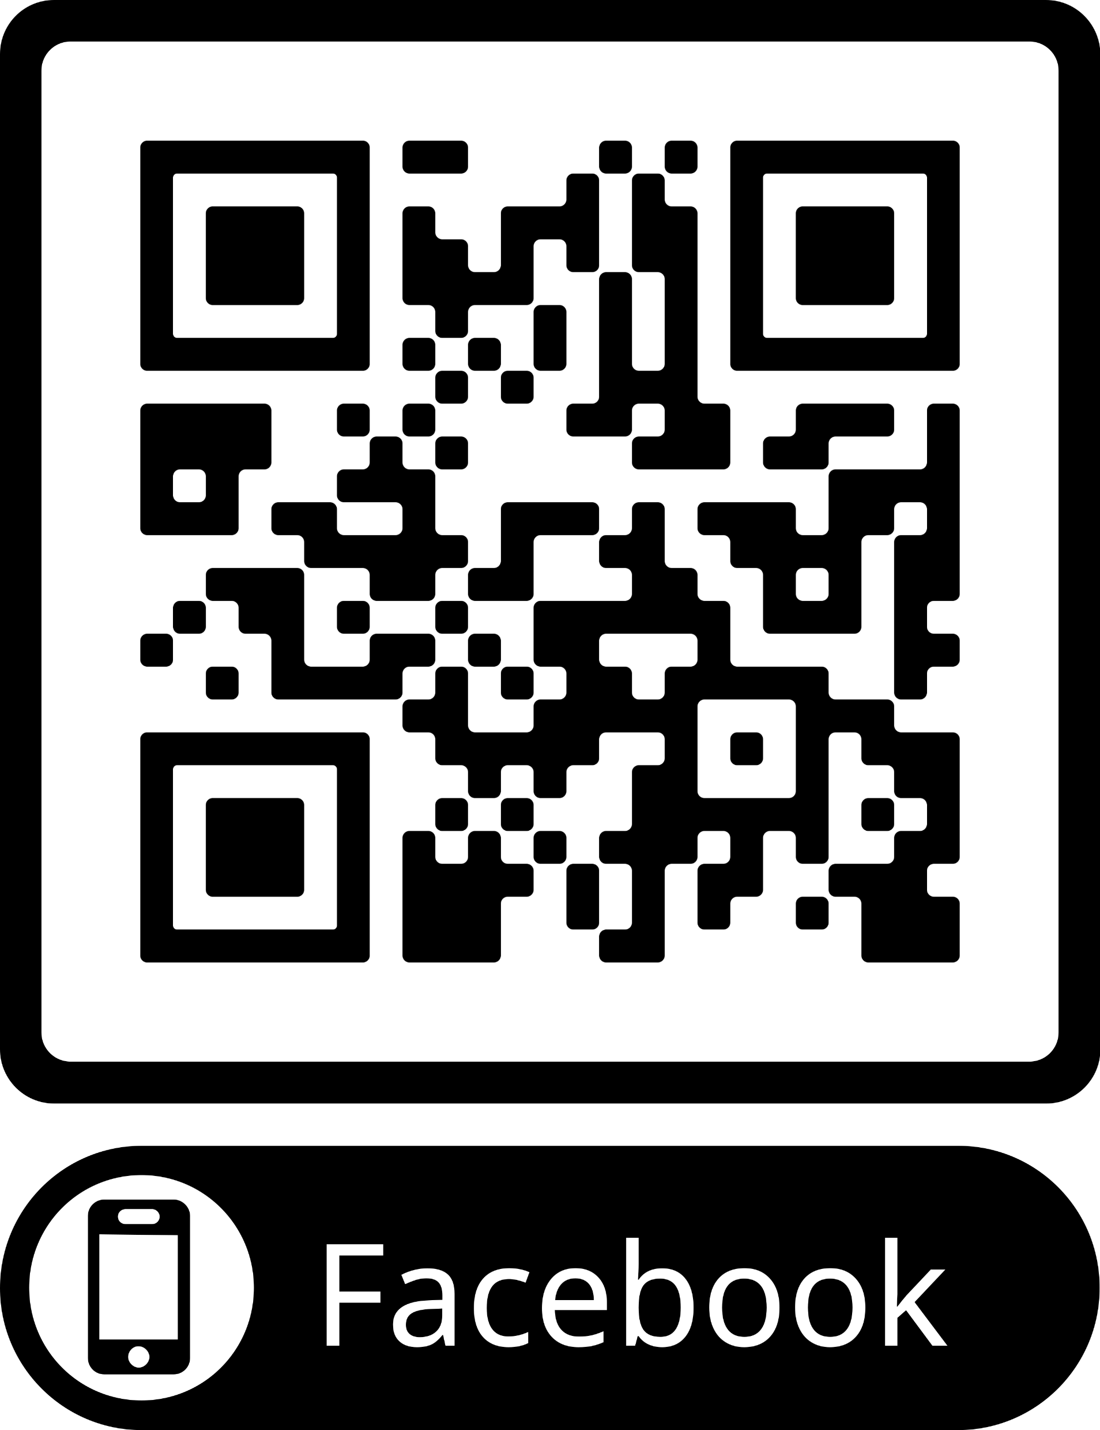
Additional National PTA
DEI Committee Resources
National PTA Quick Tips & Tools
Facebook Group – discussion and networking
LouisianaPTA.org
Notes:
National PTA’s policy describes that an organization must value differences and similarities in people through actions and accountability.
Since developing this policy, National PTA has been taking action to support implementation of this policy at every level of PTA. Some examples include:
Working with State PTAs to develop their diversity and inclusion plans
Launching the Diversity & Inclusion Toolkit, which you can find at PTA.org/Diversity
Evolving the special education toolkit, which you can find at PTA.org/SpecialEducation
Advocating on a number of resolutions including one of our most recent resolutions focused on protecting LGBTQ students as a protected class
Promoting a public awareness and leadership development campaign focused on educating our PTA leaders about the ways to engage under-represented families in PTA called Every Child in Focus. We have numerous tools for sharing and leadership development at PTA.org/EveryChild
Finally, we have been celebrating Diversity & Inclusion at each level of PTA – local, regional and state – to recognize excellence in Diversity. It is called the Jan Harp Domene Diversity & Inclusion Award. So be sure to be apply if Diversity & Inclusion is something you’ve worked hard to embody at your PTA!
IF YOU HAVE TIME:
Now that you know what diversity and inclusion mean and why it’s so important for PTA, let’s talk about how you can bring it to life in your PTA.
We’ll open up that Diversity & Inclusion Toolkit and share some initial steps to get started.
[CLICK TO NEXT SLIDE]

Slide 12

Questions
LouisianaPTA.org

Slide 13

Contact Information
Dianira Young (Dia)
National PTA DEI Committee Member
985-318-9503
Email: dei@louisianapta.org
LouisianaPTA.org

