Slide 1
PTA Leadership Training Programs & Grants
Hosted by Louisiana PTA
LouisianaPTA.org
treasurer@LouisianaPTA.org

Slide 2
Why are we here? Why do you PTA?
To make every child’s potential a reality
by engaging and empowering families and communities
to advocate for all children.

Slide 3
What are “Programs?”
PTA is more than just host teacher luncheons.
We have an opportunity to advocate for children in all kinds of ways, big and small, in the classroom and on Capitol Hill, and to create a strong community in the process. PTA Programs are events and activities that Local PTA Units can host at their schools to improve educational opportunities for all students.
National PTA (PTA.org) provides engaging, educational, and fun programs that inspire, recognize, and impact all students and their families.
Louisiana PTA (LouisianaPTA.org) has programs or contests that provide more opportunities to enhance students’ educational experiences.
LouisianaPTA.org

Slide 4
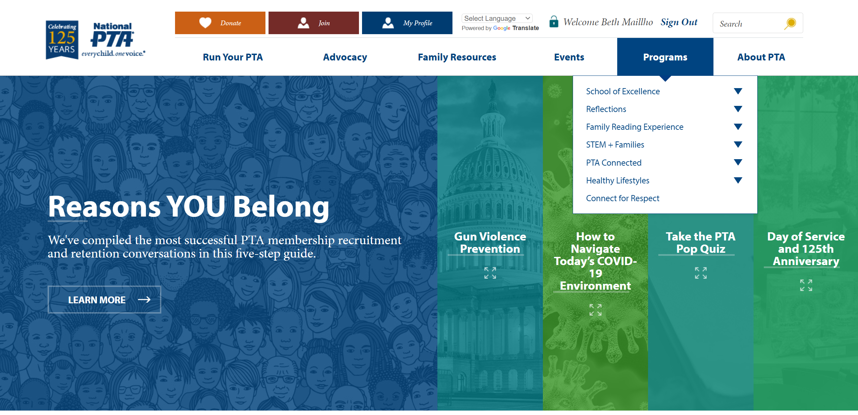
PTA.org
1. Create an account.
2. Click Programs.
PTA is more than just a teacher luncheon.
LouisianaPTA.org

Slide 5
National PTA Programs
School of Excellence is a designation awarded to PTAs and their school for doing a great job fulfilling the mission of PTA. The PTA nominates itself.
2022-2023 Winners:
A.C. Steere Elementary, Shreveport
2021-2022 Winners:
Eden Gardens Fundamental Magnet PTA, Shreveport
Fairfield Elementary Magnet PTA, Shreveport
Mandeville Elementary School PTA, Mandeville
Marigny Elementary School PTA, Mandeville
South Highlands Elementary Magnet PTA, Shreveport
PTA.org/programs

Slide 6
National PTA Programs
Reflections is a 50+ year old arts education program that provides recognition of and access to the arts in 6 categories: Dance Choreography, Film Production, Literature, Music Composition, Photography, and Visual Arts.
Age divisions are PreK–Grade 2, Grades 3–5, Grades 6–8, Grades 9–12, and Special Artist (all ages with ADA Sec. 504). Enter all age groups for your PTA.
To participate, provide reflections contact information (register) with LAPTA at LouisianaPTA.org/reflections.
The LAPTA portal entry link will be shared in December from LAPTA.
Participate in the LAPTA monthly Zoom calls. August 30 is next Zoom call.
PTA.org/programs

Slide 7
National PTA Programs
Family Reading Experience supports the development of literacy skills and encourage a love of reading through access to books through events and activities.
Literacy Activities to Host for the School: “Events and Activities for PTAs Toolkit” includes 7 programs.
Family Resources to share with the School Community: “Information Distribution Toolkit” includes 20 programs.
PTA.org/programs

Slide 8
National PTA Programs
STEM+ Families Programs foster passion for science, technology, engineering, and math through fun activities and by involving families in these experiences together. The programs aim to inspire students to pursue career opportunities in STEM fields. These are great for Science or Family Engagement Nights.
STEM at Home Activities – 6 activities with instructional videos & printables
STEM at Home Kits – 10 kits with spreadsheets, videos, and printables
Careers in STEM
PTA.org/programs

Slide 9
Northshore Technical Community College
The Gator Mobile STEM Lab and Mobile Mechatronics Lab are outfitted with state-of-the-art equipment for hands-on career exploration, STEM events, career fairs, mobile testing, and skills training. Serving Orleans, St. Tammany, Tangipahoa, Livingston, Washington and St. Helena. Programs are customizable to any grade level. Starlab® features a portable digital planetarium which sets up in a school gym or similar large room. Programs are customizable to any grade level. Contact 985-545-1231 or charlescrabtree@northshorecollege.edu.
Northwest LA Technical Community College can present at schools about their college. Contact Shay Hudson at (318) 676-7811, ext 162.
Shreveport Area

Slide 10
National PTA Programs
PTA Connected strives to help children act safely, responsibly, and thoughtfully online, especially with social media. It connects parents with tools, research, and support to make the best decisions for their children. Each Program has its own toolkit with Planning, Promoting, Hosting, and Wrap Up support information.
Be Internet Awesome Event is an interactive night where families engage with one another in meaningful conversations about raising children in an online world.
The Smart Talk is a free tool that helps caregivers and kids (ages five to 17) have positive, proactive technology conversations and set healthy digital limits together.
Digital Families Community Events includes social media and technology use strategies
Create with Kindness helps children navigate social media safely and responsibly.
Access from AT&T provides low-cost internet service for qualified households.
PTA.org/programs

Slide 11
National PTA Programs
Healthy Lifestyles is committed to improving the overall health and well-being of families across the country because we know living a healthy lifestyle is a key component to our students' ability to thrive. This program has 3 areas:
Healthy Bodies (physical health) includes school meals, school wellness, physical activity, and physical education; what PTAs can do; fundraisers; and grants
Healthy Minds (mental health) for families and a toolkit for PTA Leaders (Listen, Partner, Share, Facilitate) with webinars
Healthy Earth (environmental responsibility) includes gardening, recycling, and climate-focused programs
PTA.org/programs

Slide 12
National PTA Programs
Connect 4 Respect works to prevent bullying behavior by creating a positive school climate from the physical building to policies, staff, and peer culture. School climate encompasses everything that contributes to a student's experience with a school—from the physical building to policies, staff and peer culture.
Use the Connect for Respect (C4R) Toolkit to guide your PTA/PTSA in engaging students in improving the school climate and reducing bullying.
Get Started
Asses current school climate
Engage the school community in dialogue
Develop an action plan
Educate and empower students, families, and the community
PTA.org/programs

Slide 13
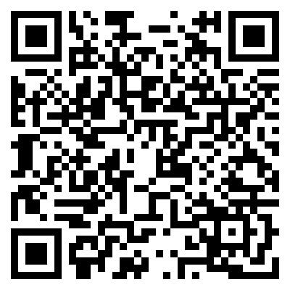
Louisiana PTA Programs and Contests
See LouisianaPTA.org/contests or LAPTA Toolkit: Awards, Grants, and Contests Sec 11 for details, sample flyers, and submittal directions.
Safety Poster Contest promotes fire safety in conjunction with Fire Safety Week and Sparky the Dog who is also 100 years old for Pre-K through Grade 6, plus Special Artists with ADA Sec 504. Winning entries from Local PTA Units are submitted digitally through JotForm. National Celebration Week: October 9-15, 2022
Deadline to submit to LAPTA: October 18, 2022
Quantity Offered: 9 (Three/category)
LAPTA Winners Announced: October 21, 2022
Judged by LA State Fire Marshall Dan Wallace!
LouisianaPTA.org/contests

Slide 14
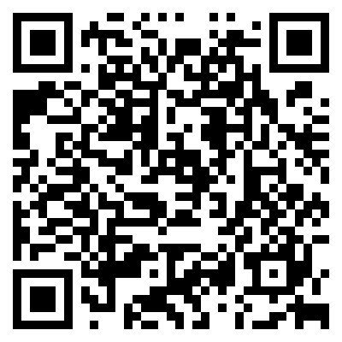
Louisiana PTA Programs/Contests
See LouisianaPTA.org/contests or LAPTA Toolkit: Awards, Grants, and Contests Sec 11 for details, sample flyers, and submittal directions.
Love Louisiana Video Challenge celebrates all things wonderful about Louisiana and our children’s education. LAPTA wants video submissions from students expressing what makes Louisiana special. Winning entries from Local PTA Units are submitted digitally through JotForm.
Deadline to Submit to LAPTA: February 28, 2023
Quantity Offered: 15 (Three/category)
Winners Announced: March 25, 2023
LouisianaPTA.org/contests

Slide 15
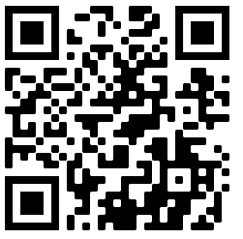
Louisiana PTA Programs/Contests
See LouisianaPTA.org/contests or LAPTA Toolkit: Awards, Grants, and Contests Sec 11 for details, sample flyers, and submittal directions.
2024-25 Reflections Theme Search is looking for a future Reflections theme! The final winning entry for National PTA will receive a $100 prize. Students submit their entries directly with LAPTA.
Deadline: November 10, 2022
Students directly submit to LAPTA
Winners Announced: November 28, 2022
LouisianaPTA.org/contests

Slide 16
Create Your Own PTA Programs
Be inclusive (flexible hours, translators, etc). Some ideas:
Used Uniform Sale
Basics Needs Closet (Uniform giveaways to those in need)
Welcome Back to School Parade for the staff
Mentor-a-PTA (established PTA gives a helping hand to another PTA)
Beautification Planting Day
Host a Medical Clinic for routine annual check-ups (cut down on absences)
Newsletters and e-mail blasts
S’mores & Cocoa Event
Survival Guide for [High School] or Parent Toolkits
Share Summer Reading programs from PTA.org or at the local library
What programs, events, or activities can you share?
LouisianaPTA.org

Slide 17
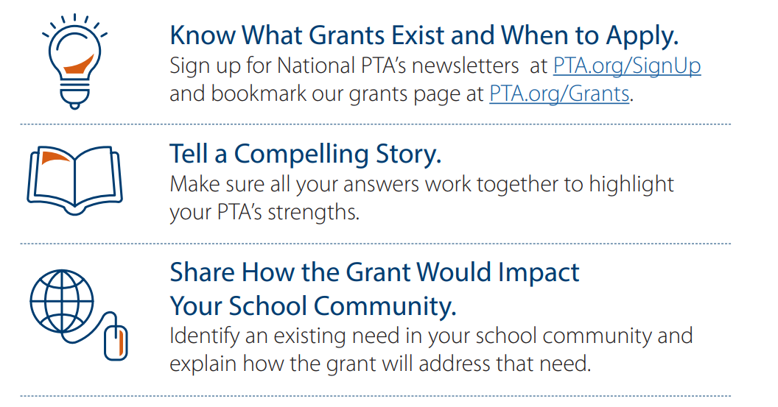
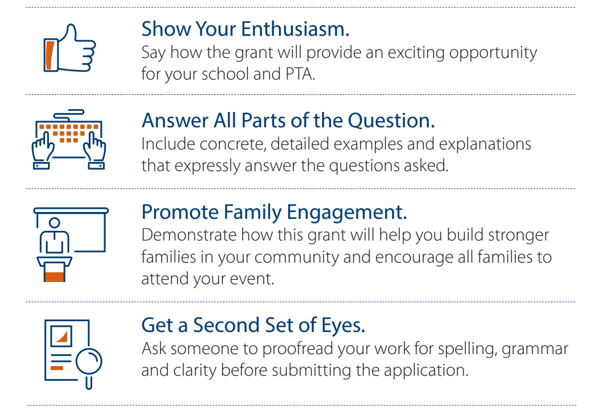
What are “Grants?”
A grant is a sum of money given by an organization for a particular purpose. National PTA and Louisiana PTA have grants for PTAs and PTA members. There are endless other entities that give money away. Grant writing tips:
LouisianaPTA.org/grants

Slide 18
National PTA Grants
The Judson Warriors PTA won a $300 grant from National PTA to host a faculty learning event for an active shooter on campus.
Previous grants included:
Advancing Diversity, Equity & Inclusion Grant Recipients
STEM + Families Science Festival Grant Recipients, Sponsored by Bayer Fund
STEM + Families Math Nights Grant Recipients, Sponsored by Mathnasium
PTA Tobacco Prevention Campaign Grant Recipients, Sponsored by The Campaign for Tobacco-Free Kids
Create with Kindness Grant Recipients, Sponsored by TikTok
PTA.org/grants

Slide 19
National PTA Grants
National PTA offers awards or grants to honor or support PTAs as they engage families, support student success, improve the health and safety of students and families, increase access to arts education or celebrate advocacy and diversity.
Go to PTA.org and select Awards & Grant Opportunities under the Run Your PTA Menu.
New grant opportunities will be released on August 23, 2022.
National PTA Grant Deadline: September 27, 2022, at 4:00pm.
Applying for National PTA grants is an easy process and worth your time.
$650,000 available for PTAs
If you need assistance, contact LAPTA at President@LouisianaPTA.org.
PTA.org/grants

Slide 20
National PTA Grants: Judges’ Rubric
Barriers and Equity: The answer clearly explains the barriers, how they will address those barriers, and provided concrete examples for how they will use this grant funding to address those barriers. For example: translation needs/obstacles, advertising events, offering transportation, hosting programs at multiple dates/times so all can participate.
Community Needs: The answer explains how they determine community needs, how they gained input from individuals of all identities and backgrounds, and how the selected program(s) will meet those needs in significant detail. For example: using a survey, hosting a listening session, asking questions at a PTA meeting, launching a poll, calling members.
LouisianaPTA.org/grants

Slide 21
National PTA Grants: Judges’ Rubric
Family and Community Engagement: How will you ensure that your entire family-school community is fully engaged in the program(s) you offer? How will you intentionally engage other or new members of your PTA in the planning, design, delivery and wrap-up of your program? (For example: personalizing invitations and outreach, including a welcome table, setting up activities so families are working together and sharing out information, including time for relationship-building, providing questions or take-home activities that families can utilize together, creating friendly-family competitions with incentives)
Grant-Specific Questions: Does this applicant show an understanding of the specific National PTA program for which they are applying? The answer demonstrates explicitly how the specific National PTA program and resources will be implemented.

Slide 22
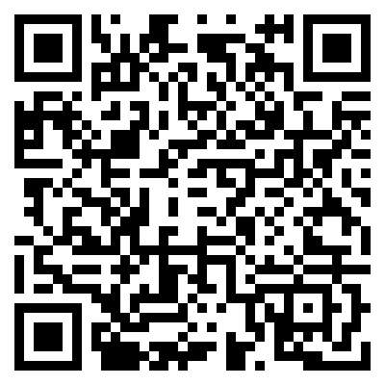
Louisiana PTA Grants
The $750 Reading and Literacy Grants help PTA Units host literacy events at their schools. Literacy skills in Louisiana are unacceptably low, and LAPTA made literacy opportunities a priority for our children. Literacy skills in Louisiana are unacceptably low, and LAPTA is making literacy opportunities a priority for our children. For possible programs, reference PTA.org/home/programs/family-reading.
Application Deadline: November 4, 2022
Apply at https://form.jotform.com/221748002230038
Winners Announced: December 2, 2022
Quantity Offered: 4 (One/category)
LouisianaPTA.org/grants

Slide 23
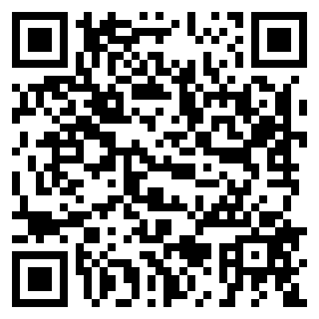
Louisiana PTA Grants
The $750 Healthy Minds Grants encourage PTA Units to host mental health program. The mental health of all children, parents, and caregivers before, during and after challenges arise is immensely important. Make mental health a priority for your PTA and school.
Application Deadline: March 27, 2023
Apply at https://form.jotform.com/221748198534162
Winners Announced: May 1, 2023
Quantity Offered: 4 (One/category)
LouisianaPTA.org/grants

Slide 24
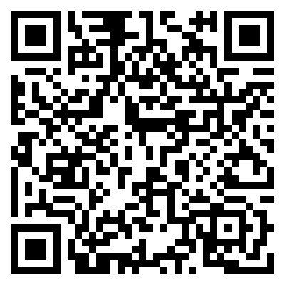
Louisiana PTA Grants
The $500 Day of Service Grants encourage PTA Units to reach beyond the school and into the community to make a difference. Where is there a need? Who needs the PTA? February 17 is the National PTA Founders’ Day! How can you continue the legacy of PTA?
Application Deadline: February 17, 2023
Apply at https://form.jotform.com/221748846538166
Winners Announced: March 25, 2023
Quantity Offered: 4 (One/category)
LouisianaPTA.org/grants

Slide 25
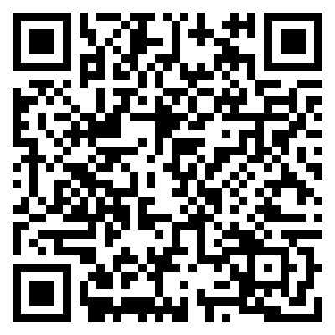
Louisiana PTA Grants
The $500 Creative Teacher Grants support creative, innovative, and fun programs or projects for students. Grants may fund any activity or material which supports student enjoyment, wonder, and engagement. Bring back joy!
Application Deadline: February 28, 2023
Apply at https://form.jotform.com/221796420623152
Winners Announced: March 25, 2023
Quantity Offered: 2
LouisianaPTA.org/grants

Slide 26
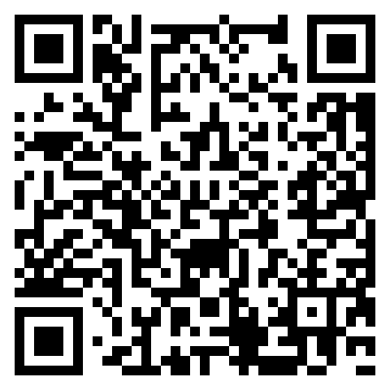
Louisiana PTA Grants
The $75 National PTA Virtual Legislative Convention Grants pay the registration fee for PTA members to virtually attend the Legislative Convention (LegCon). LegCon is an annual conference where PTA leaders join forces to influence Congress in Washington, DC. Day one is training. Day two is meetings with the politicians.
Application Deadline: January 20, 2023
Apply at https://form.jotform.com/221776439055159
Winners Announced: February 28, 2023
Quantity Offered: 20
LouisianaPTA.org/grants

Slide 27
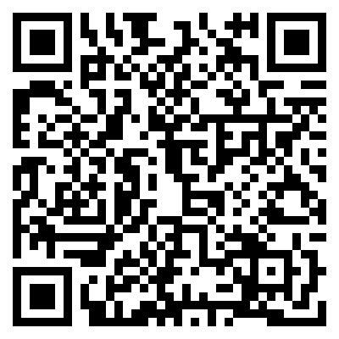
Louisiana PTA Grants
The $75 National PTA Virtual Convention Grants pay the registration fee for PTA members to virtually attend the National PTA Convention. Experience all that National PTA does behind the scenes for the children of our country. It is an incredible opportunity!
Application Deadline: February 28, 2023
Apply at https://form.jotform.com/221787416402152
Winners Announced: March 25, 2023
Quantity Offered: 20
LouisianaPTA.org/grants

Slide 28
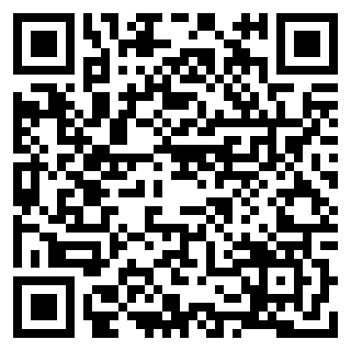
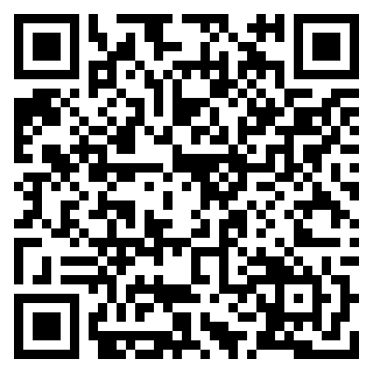
Louisiana PTA Awards – Mentor-a-PTA
Deadline for Award Application: February 28, 2023
Apply at: https://form.jotform.com/221777772070056
Winners Announced: March 25, 2023
Quantity Offered: 2
Louisiana PTA Awards – Outstanding Newsletter
Application Deadline: February 1, 2023
Apply at: https://form.jotform.com/221745628447059
Winners Announced: March 25, 2023
Quantity Offered: 3
LouisianaPTA.org/grants

Slide 29
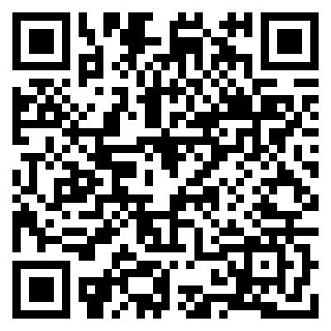
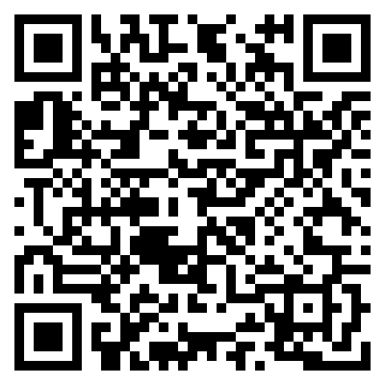
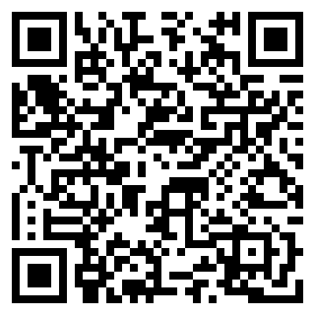
Louisiana PTA Awards – Volunteer of the Year
Application Deadline: February 28, 2023
Apply at: https://form.jotform.com/221787194277165
Winner Announced: March 25, 2023
Quantity Offered: 1
Louisiana PTA Awards – Advocacy Awards for a Local PTA Unit or a Student
Application Deadline: February 1, 2023
Winners Announced: March 25, 2023
Quantity Offered: 2 for each
PTAs
Students
LouisianaPTA.org/grants

Slide 30
Questions
Contact Information
Beth Maillho
Louisiana PTA Treasurer
(985) 778-5799
treasurer@LouisianaPTA.org
LouisianaPTA.org

